Slide 2
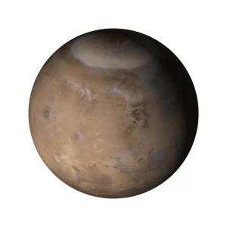
Exploring Mars
Prepared by: Dr. Parshati Patel,
Education & Outreach Program Coordinator

Slide 3
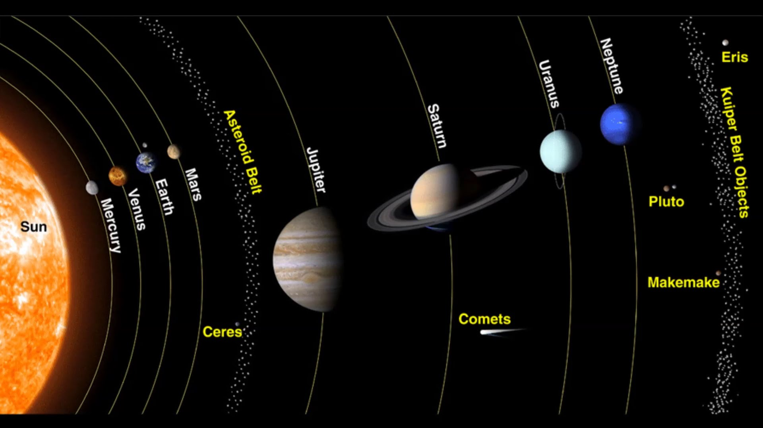
The Solar System
Notes:
- 4th planet of our solar system
=> last rocky planet
- Most Earth-like planet of our solar system
- 2 satellites: Phobos and Deimos

Slide 4
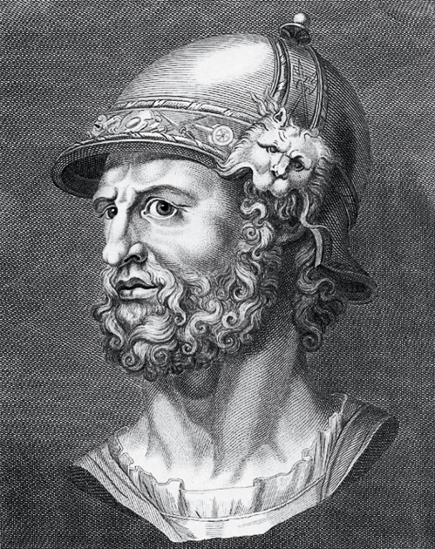
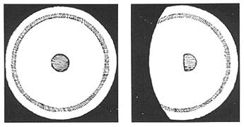
HISTORY
Roman God of War
Egyptians, Babylonians, Greeks, Chinese, Indians,…
Galileo, 1610:
first telescopic observations
Francisco Fontana, 1636/1638
first drawings of Mars
Notes:
red colour – associated with war and bloodshed, detailed observations (position, size, distance)
the circle in the middle is likely an optical defect from his telescope (saw the same feature on Venus, which we know doesn’t exist)
The history of our thoughts on Mars goes back to the mythological associations - Mars [Greek: Ares], Roman god of war

Slide 5
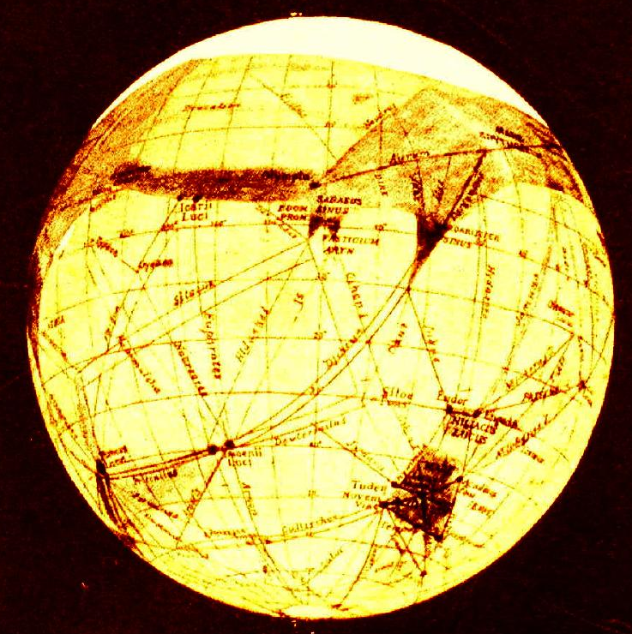
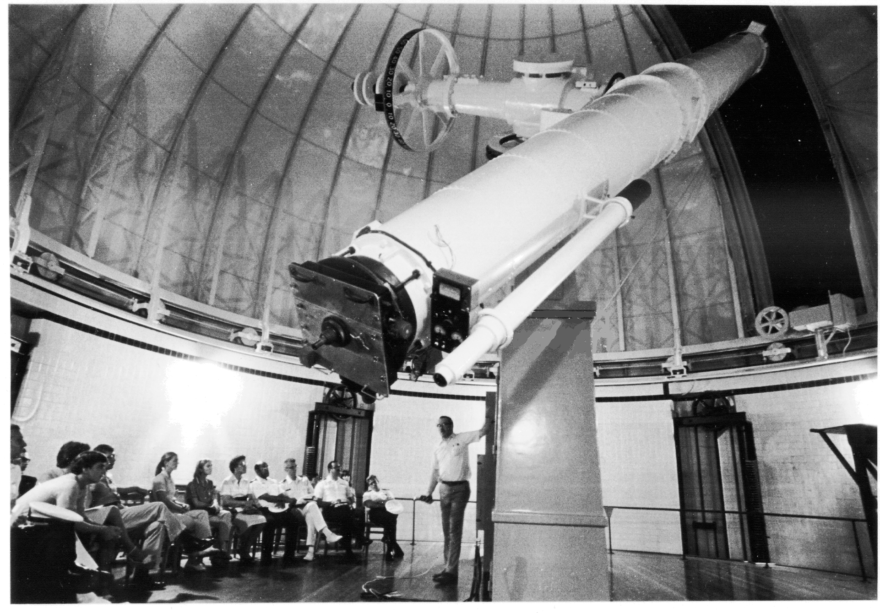
HISTORY
Herschel, 1781: polar cap variations
Giovanni Schiaperelli, 1860s: numerous channels (canali)
Hall, 1877: Phobos and Deimos
1900s: Portrayal of Mars in media
Notes:
Herschel noted changing sizes of polar caps
Asaph Hall; named after the horses that pull the chariot of mars; telescope used was at 26 inch refractor (we have a 10 inch refractor)
A whole new epoch in Mars studies came with the reports bi Giovanni Schiaperelli in the 1860s that he saw numerous channels (canali), immediately and sloppily translated into English as "canals". The implications were rather different... The existence of the canals was a matter of heated debate for decades, with skilled observers being either utterly convinced of their existence or equally convinced that they were misperceptions of scattered details. Clearly the dean of canal theorists was Percival Lowell
Mars has remained in the human imagination, and not even the rise of science and technology has interrupted our wary fascination with this neighboring world.
Were these Martians warlike and should we fear an invasion? Radio convinced us "yes" when a 1938 broadcast of "War of the Worlds" scared millions of listeners into believing that tentacled creatures had landed on Earth in their war machines.

Slide 6
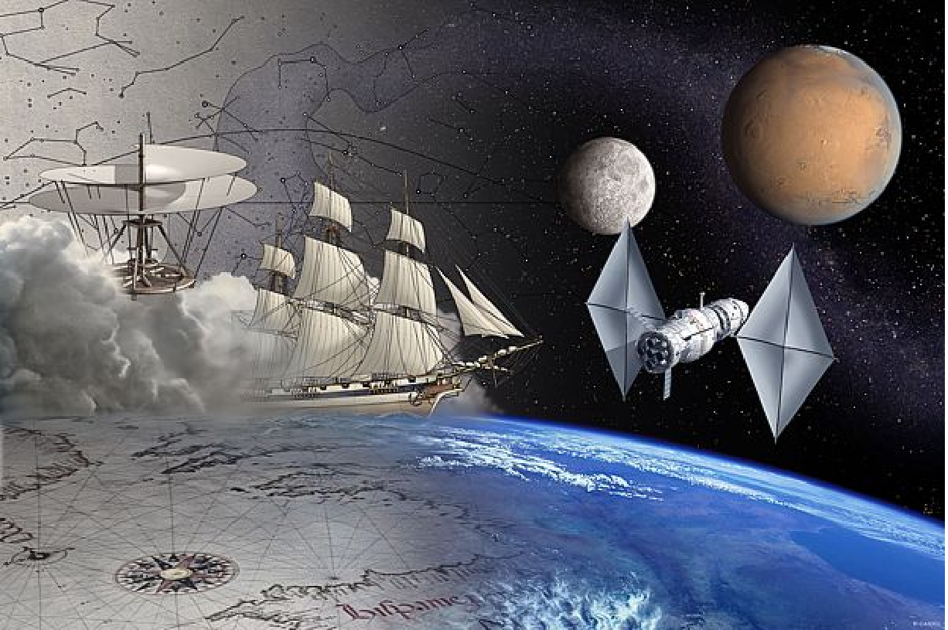
EXPLORATION – To boldly go ...
Notes:
We humans have always explored.. Here you can see an image of the ancient charts for navigation and early maps, and our means of early exploration, boats then flying machines..
On the right you can see the next frontier, space.. We are no longer exploring for new continents, but now new worlds…
Going to Mars is about exploration.. Most of us are born wanting to explore.. When we are born we want to learn to walk so we can go places ourselves, be independent, find out what is round the corner.. As we grow older, some of us keep that curiosity.. And a very few of us make exploration our lives…
This top picture shows us a nice link between exploring in the past and where we are today.. I like it specially because it’s a great introduction to our topic today – the weather.. We can see big clouds behind the sailing ship and gondola..A hundred years ago people explored by sailing ship.. And were completely dependent on the weather..
Now our next frontiers are in space.. Canadian modern day space explorers – astronauts - have already gone for a spacewalk from the US space shuttle. What we are going to talk about today – and what a lot of people are starting to talk about - is the next step.. A human expedition to the planet Mars…

Slide 7
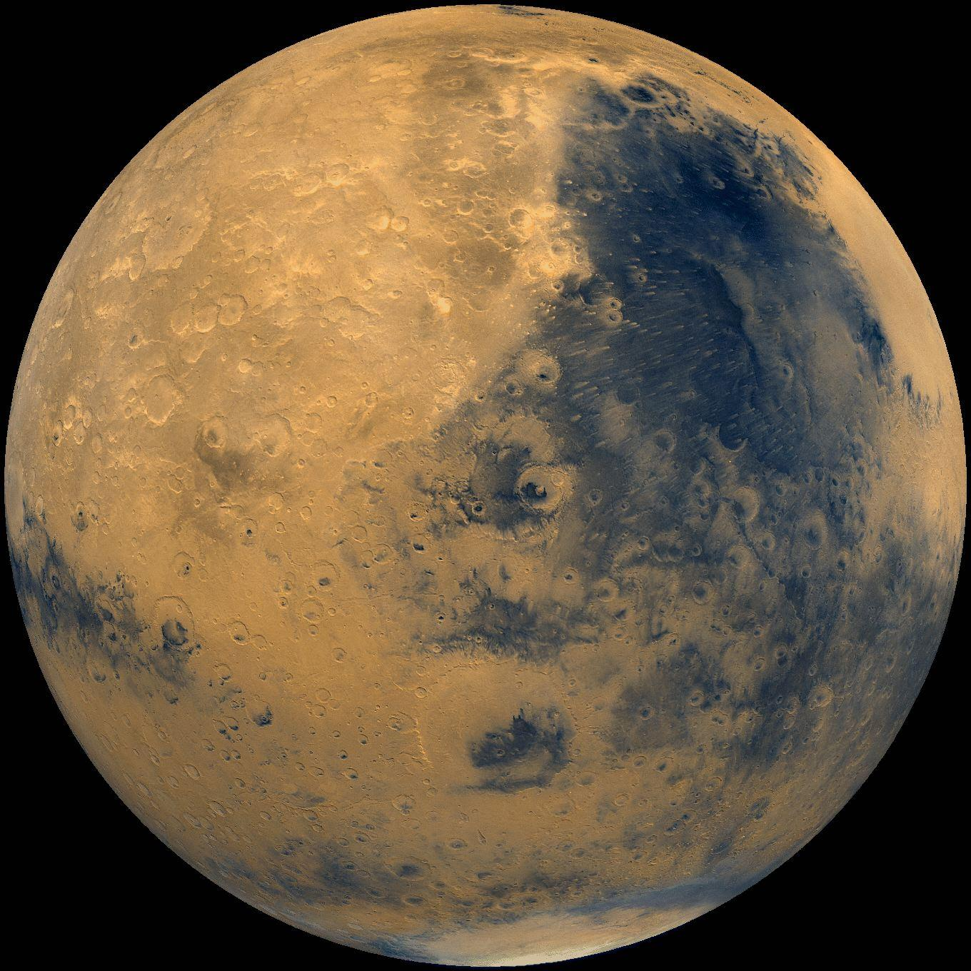
Why Mars?
Notes:
Mars is the most Earthlike planet in the Solar System
It has seasons, days similar in length to the Earth day, it has an atmosphere, and it has polar caps that change with the seasons!! No other planet has these characteristics.
Even more importantly, it is the only body in the solar system, besides the Earth, where water is known to have flowed across the surface!
So, even though Mars today, is a cold, barren planet, in its past it was probably a warm, wet planet
Liquid water is an absolute requirement for life as we know it.
This is the crux of why we want to go to Mars: to address one of the fundamental scientific questions – are we alone in the universe?!!

Slide 8
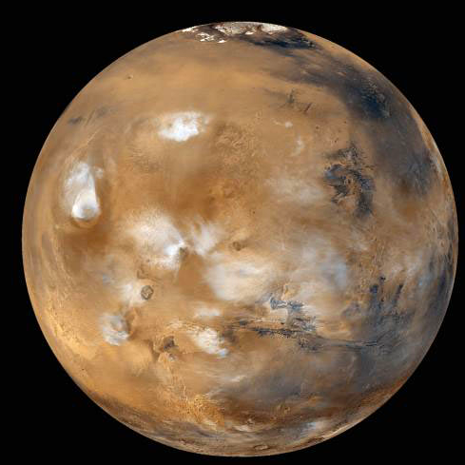
Mars Facts – Size
d
2d
Mass: 1/10 Earth
Surface gravity: 1/3 Earth
Notes:
Now, let's compare Mars to Earth:
- Size of Mars relative to Earth (diameter): 1/2 of Earth
- Size of Mars relative to Earth (mass): 1/10 of Earth
- Surface gravity => 1/3 of Earth

Slide 9
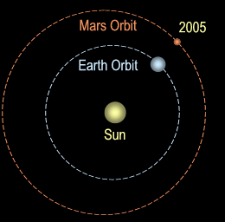
Mars Facts – Length of day/year
Martian Day: 24 hr 37 min 22.65 s
Earth Day: 24 hour
Martian Year: 668 sol = 689 days
Earth Year: 365 days
Notes:
Q: What determines the length of a day?
A: Time required for a planet to rotate about it's own axis.
e.g. It takes Earth 24 hours to rotate about its axis (1 day)
Q: How long is a Mars day?
A: It take Mars 24hr 37 min 22.65 s to rotate about its axis (1 sol)
Q: What determines the length of a year?
A: Time required for a planet to rotate around the Sun.
e.g. It takes Earth 365 days to orbit around the Sun (1 year)
Q: How long is a Mars year?
A: It takes 668 sols ~ 689 days to orbit around the Sun (1 "Mars" year)

Slide 10
Mars Facts – Distance
Earth: 150 million km
Mars: 228 million km

Slide 11
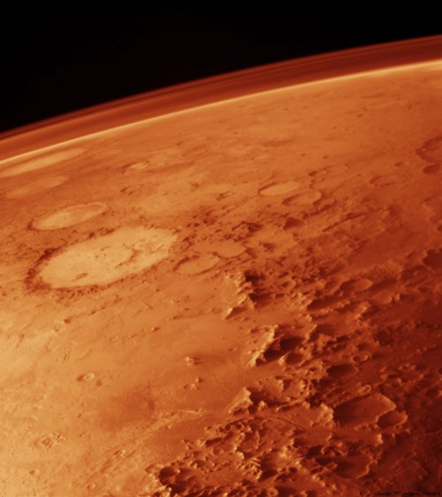
Mars Facts – Atmosphere
Earth's atmosphere:
78% N, 21% O, 1% Ar + trace gases
Martian atmospheric composition:
95% CO₂ + 5% dust + trace gases
Notes:
Before we get into the discussion of weather, let's talk about the Earth and Martian atmospheres.
Q: Does anyone know what our atmosphere is made of?
A: On Earth, when we breathe, we take in air which is composed of molecules of Nitrogen (N2), Oxygen (O2), Carbon Dioxide (CO2) and Water (H2O).
So sending someone to Mars would require sending air since the Martian atmosphere is composed of 95% carbon dioxide (CO2) + ~5% dust + trace gases
Recall: Density (kg/m³) = Mass (kg) / Volume (m³) => ρ = M / V
If I take a unit volume of steel, you can imagine that it is more dense than the same volume of wood because it is more massive. Similarly, wood is more dense than air. If we compare a unit volume of Earth's atmosphere with the same unit volume of Martian atmosphere, you would find that the density of the Martian atmosphere is 1% or air (or 60x less dense).
IMPORTANT: Air is the name given to the mixture of gas that composed the Earth's atmosphere. This name cannot be used to describe the Martian atmosphere, since it is composed of different gases in different distribution.
*******************
The Voyager and Mariner missions confirmed the martian atmosphere consists of 95.3% CO₂, with the remainder being mostly N₂ (2.7%), argon (1.6%) and minor O₂, CO, and enough water, if condensed, to fill an average swimming pool. Atmospheric pressure averages 7 millibars or about 0.7% of Earth’s, but windstorms within this thin envelope can reach speeds greater than 200 km/hr (124 mph). Clouds of water-ice are fairly common in season, especially near the poles.

Slide 12
Mars Weather – Dust storms
Notes:
Dust storms are made up of a variable distribution and size of various molecules (even potentially gas) that are not components of the standard atmosphere.
It is not known the distribution or the composition of the dust storm – this is a major issue for the understanding and characterization of the atmosphere.
Equivalent to sand storms here on earth, but Mars does not necessarily contain sand particles. Mars "dust" is composed of aerosols, i.e. microscopic soil particles, e.g. iron oxide, magnetite, silicate, etc. mixed to gases in variable amount, e.g. nitrogen, argon, etc.
Dust storms can be seen by some Mars satellite, orbiters, and even rovers (depending on their retrieval technique). Viking 2 was in 2 dust storm events. They noticed a difference in temperature and water vapor.
This would be a consideration for humans visiting Mars in terms of shelter, clothing, cleaning (off of solar panels), performance of equipment, etc
Are there areas more prone to dust storms? Actually, with the current simulations, dust storms are not predictable and vary from year to year. However, they generally occur during the same season if they do occur (during the northern fall season).

Slide 13
Dust Storms
Notes:
Global dust storm… lasts for days and covers the whole planet unlike earth (its regional)!

Slide 14
Mars Weather – Temperature
 | Earth (°C) | Mars (°C)
Coldest | -92 | -125
Hottest | +58 | +25
Average | +15 | -65
Notes:
Mars is farther from the Sun than Earth. So, less of the sun's energy reaches it and the planet is not heated as much as Earth. Also, the thinner atmosphere does not prevent the heat from escaping as much as Earth's atmosphere does.
It then results in cooler temperature and larger temperature variations between days/nights.
The coldest temperature on Mars is at its poles, just as on Earth.

Slide 15
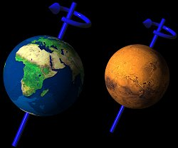
Why do we have seasons?
A: Tilt of planet relative to Sun
Notes:
Weather varies per season. Just as we have seasons here on earth, so does Mars. What causes seasons?
The Earth is on a tilt relative to its orbit around the sun. And if we take Canada, for example, we can see that in our summer season, Canada is leaning closer to the sun than in our winter season when it is tilting away from the sun.
Mars has the same tilt as the earth

Slide 16
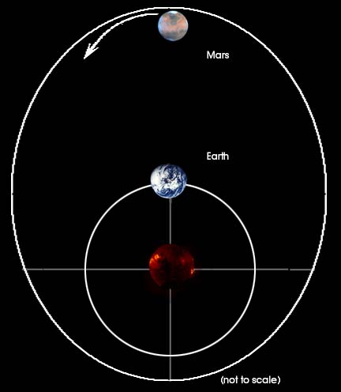
Mars has "special" seasons!
Notes:
This drawing illustrates the large differences in distance from the sun possible for Mars. (The drawing exaggerates the size scales a little).
If conditions are just right, there are times when Mars can experience a great deal more warming by the sun than normal.
Earth does not have the potential for the kind of climate extremes that Mars does.

Slide 17
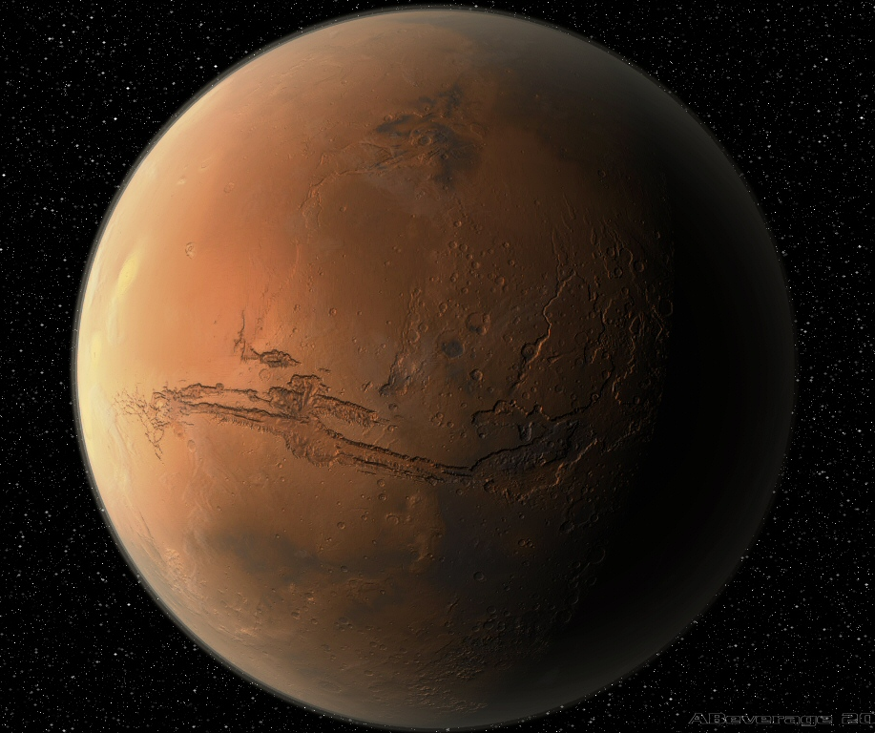
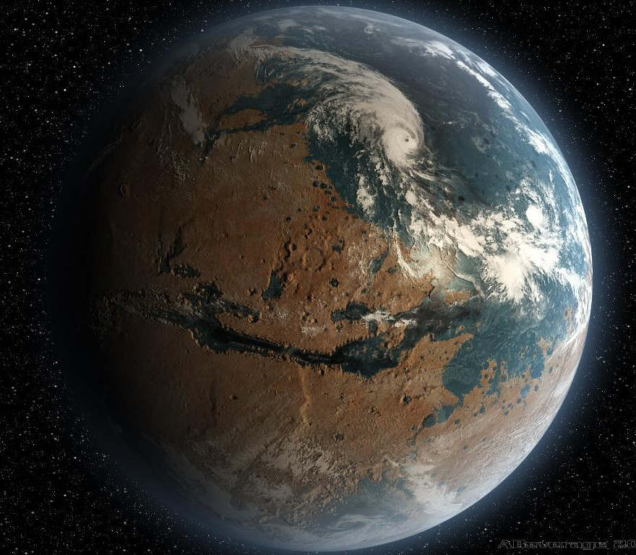
Mars climate change?
Mars is now a cold dry desert…
….but has it always been that way?

Slide 18
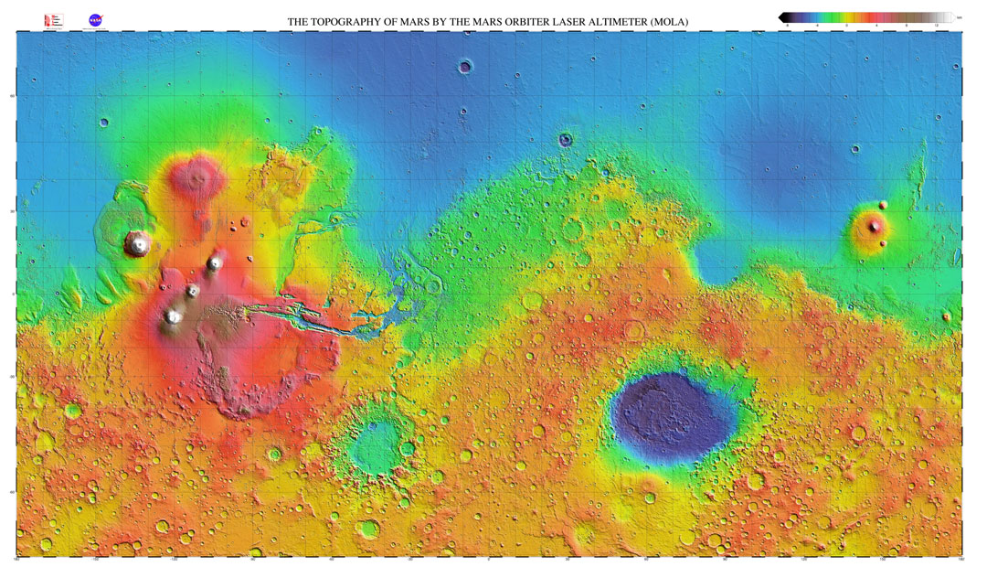
MAP OF MARS
Notes:
Blue crater at bottom: Hellas Planitia, large impact basin, formed during asteroid impact
Red area: Tharsis region, 3 large shield volcanoes, Olympus Mons is just off the region
haven’t seen any evidence of current volcanism, but some scientists still believe
southern highlands, heavily cratered
northern lowlands, smooth, few craters, (evidence of ocean?)

Slide 19
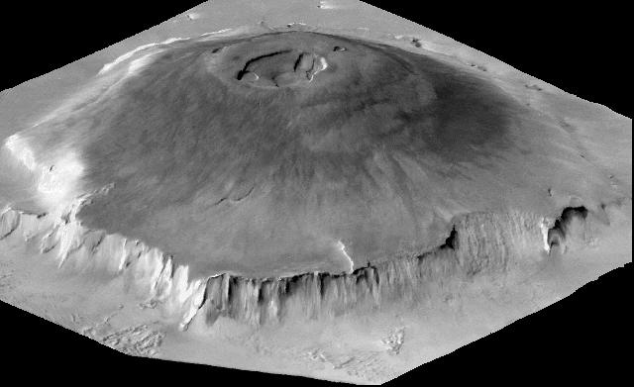
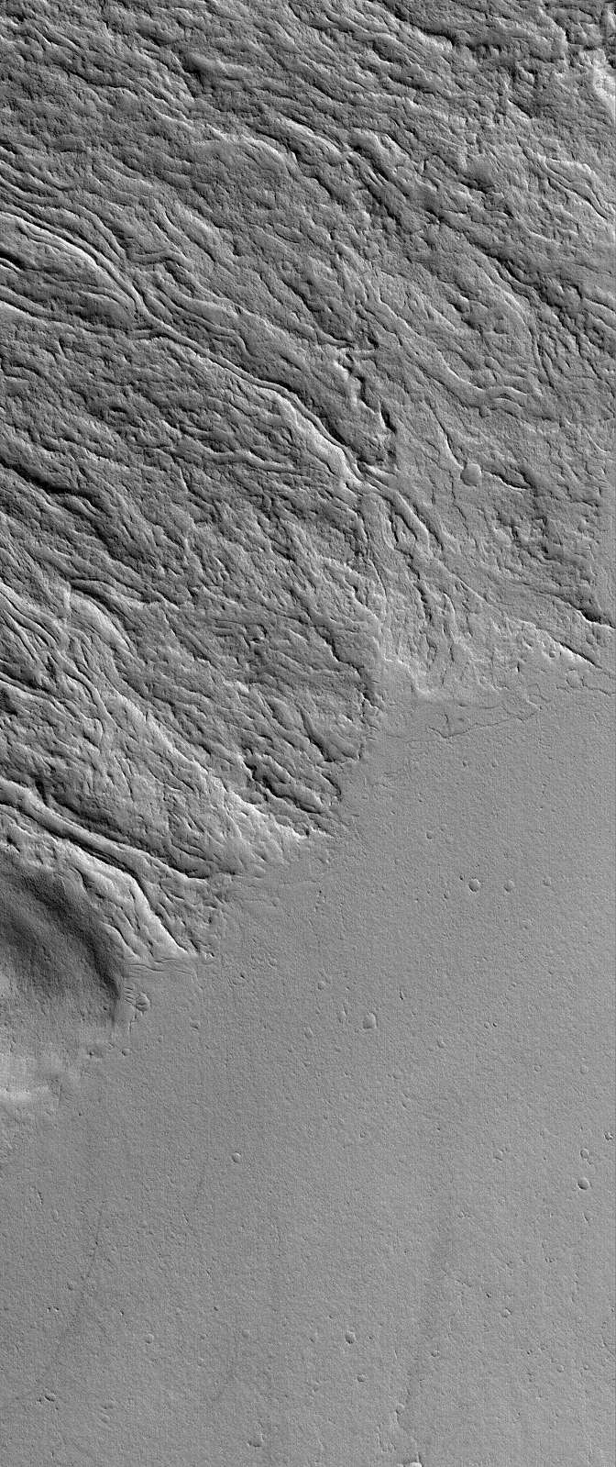
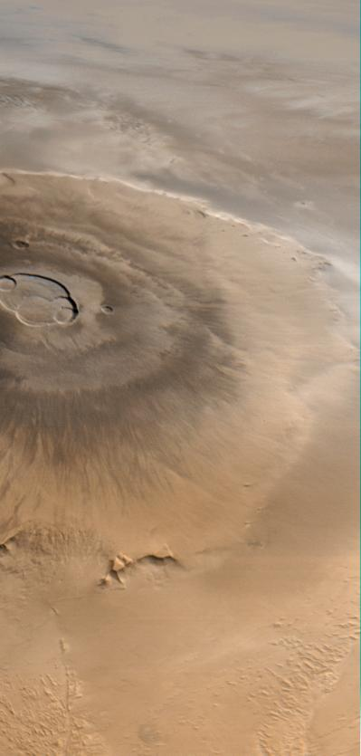
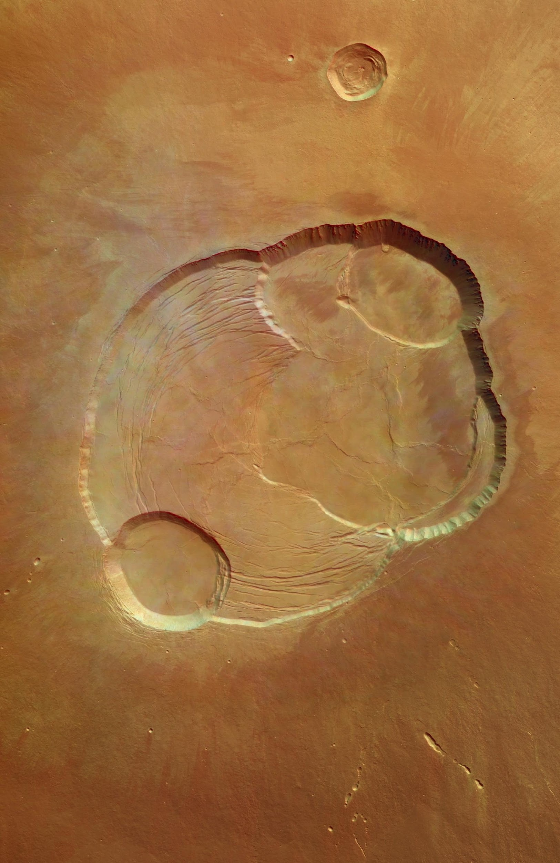
OLYMPUS MONS
550 km, 21 km
very shallow
lava flows
calderas at the top
Notes:
not currently volcanically active
calderas form following a large eruption; can’t support overtop weight and collapse
first high-res image of the complete caldera, image is 102km across
approximately the size of Arizona

Slide 20
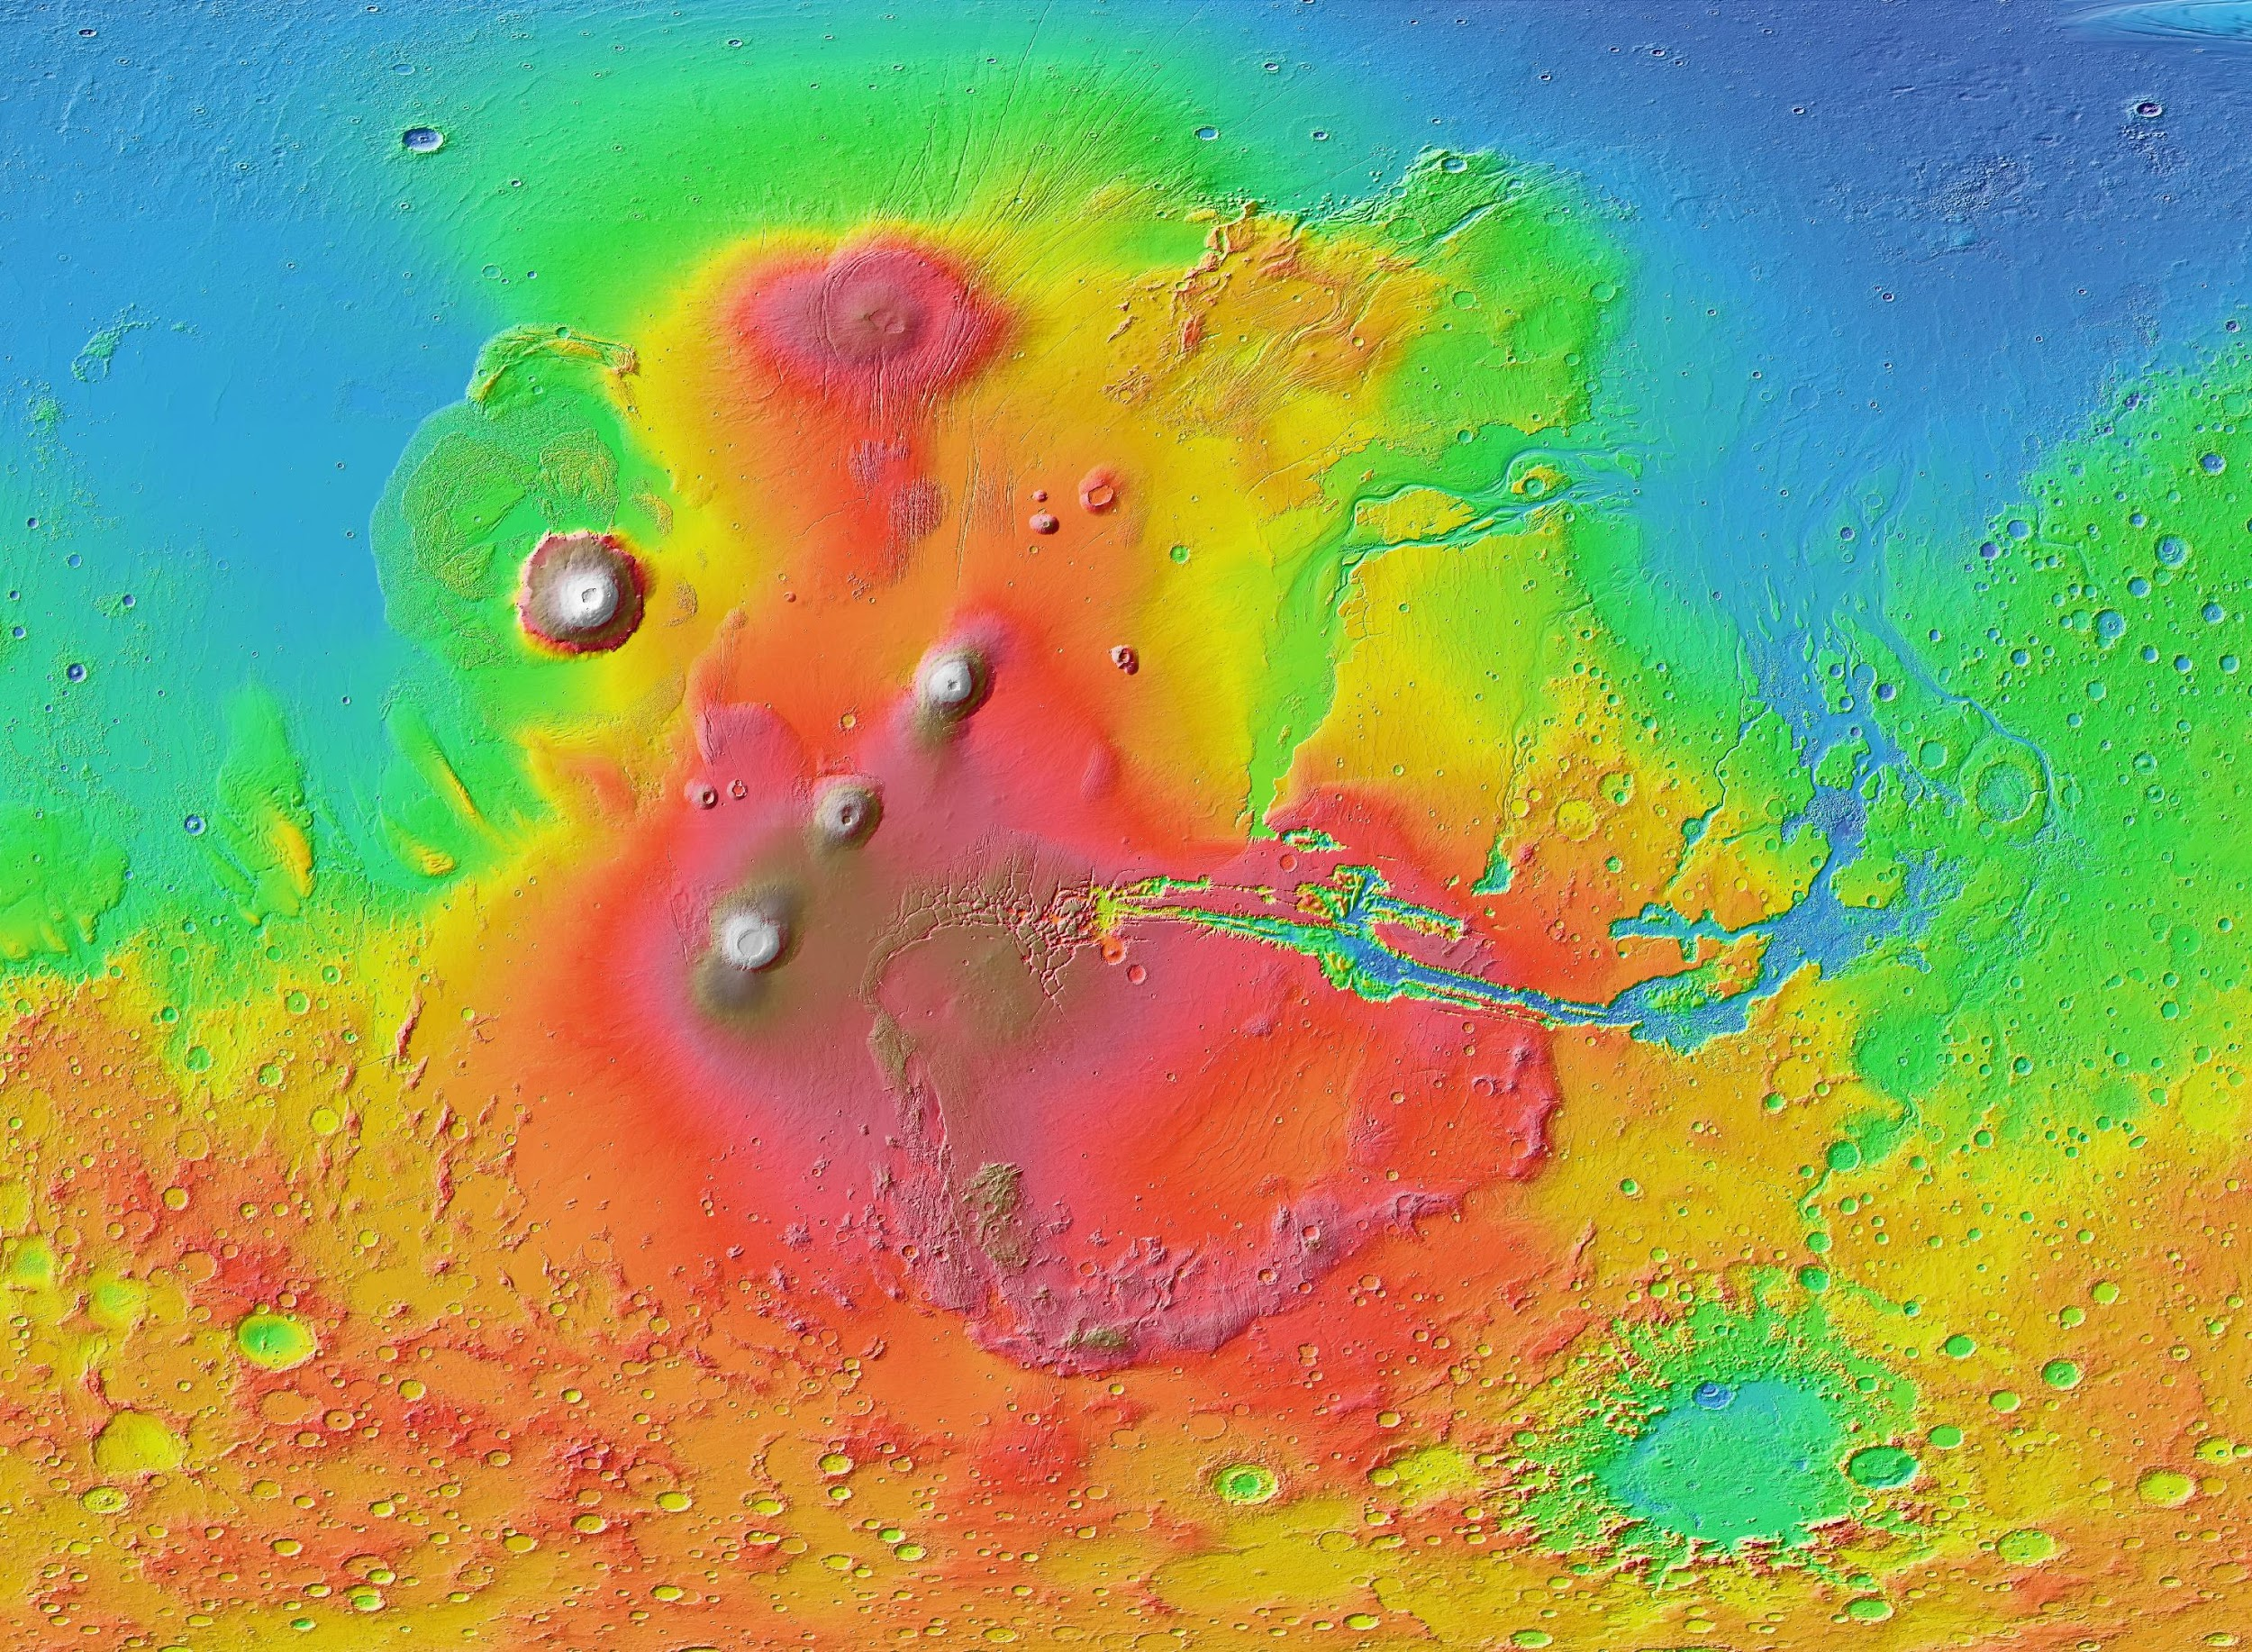
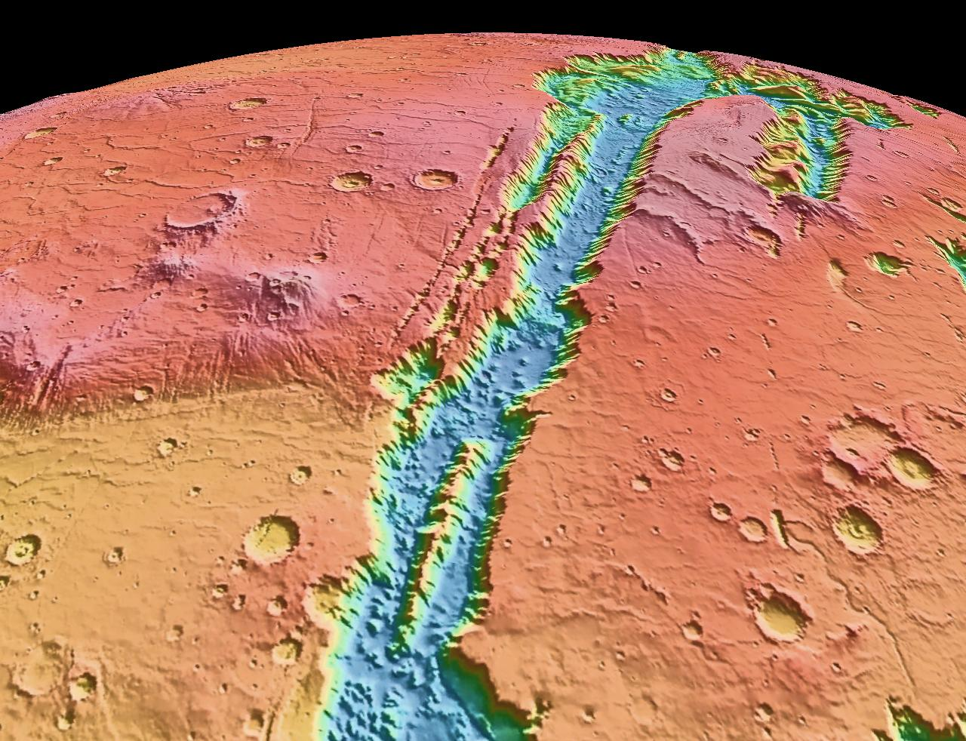
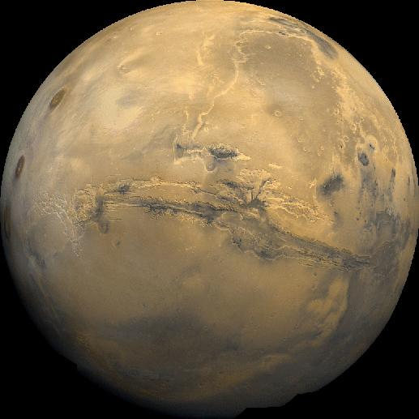
VALLES MARINERIS
4000 km X 200 km X 7 km
canyon system
Notes:
grand canyon is 800 km long and 1.6 km deep
may have been formed by water or a rift fault; formed as the planet was cooling, but there are areas that show evidence of water formation
would stretch across the US

Slide 21
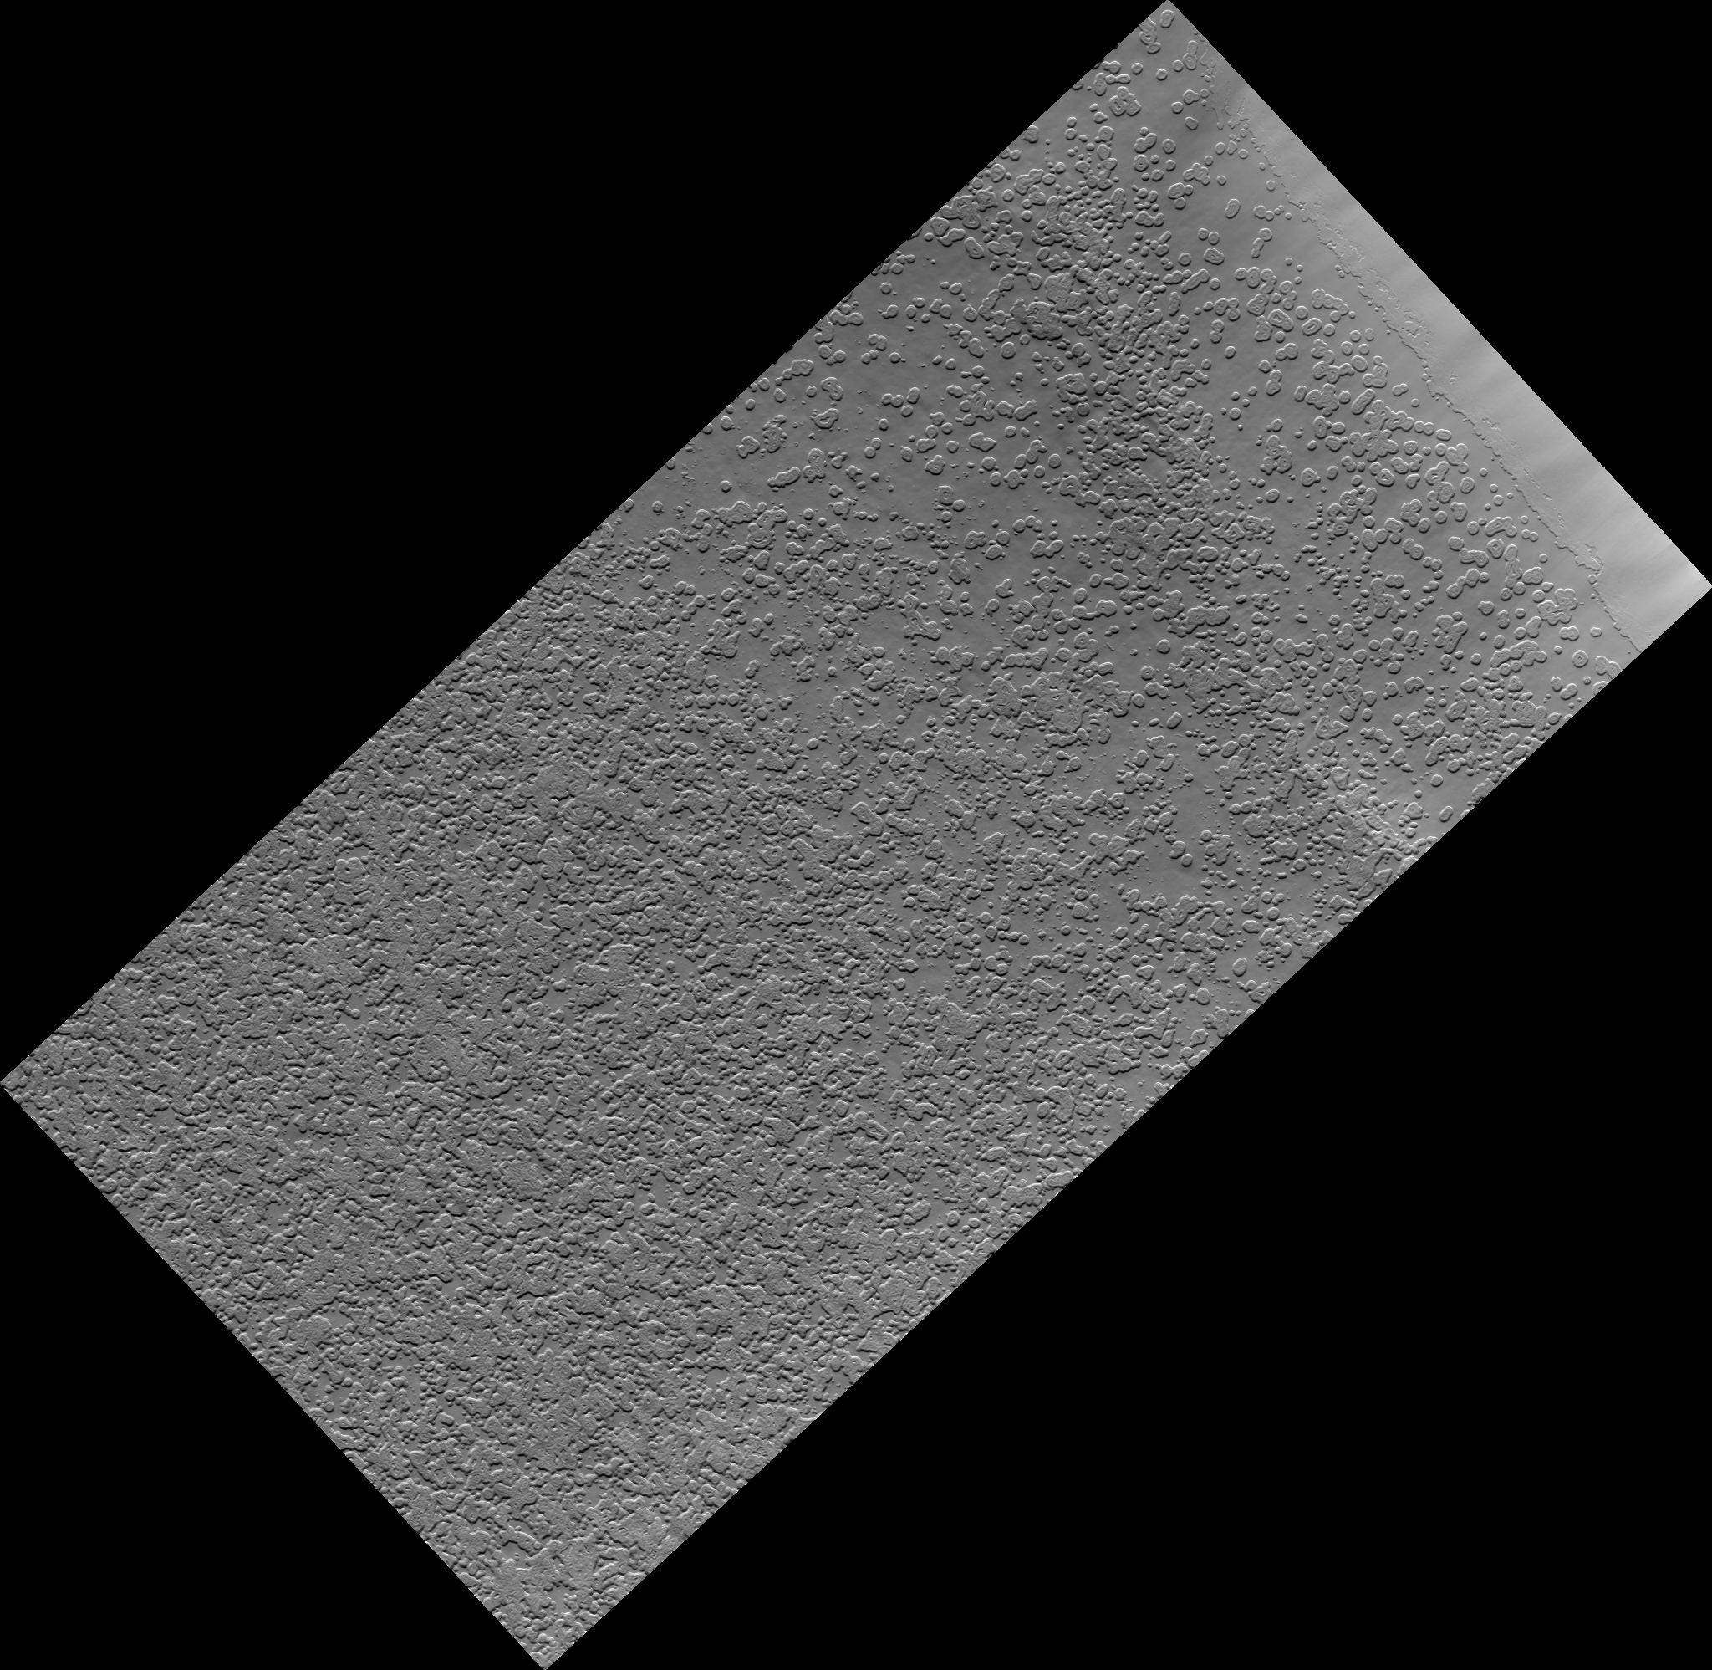
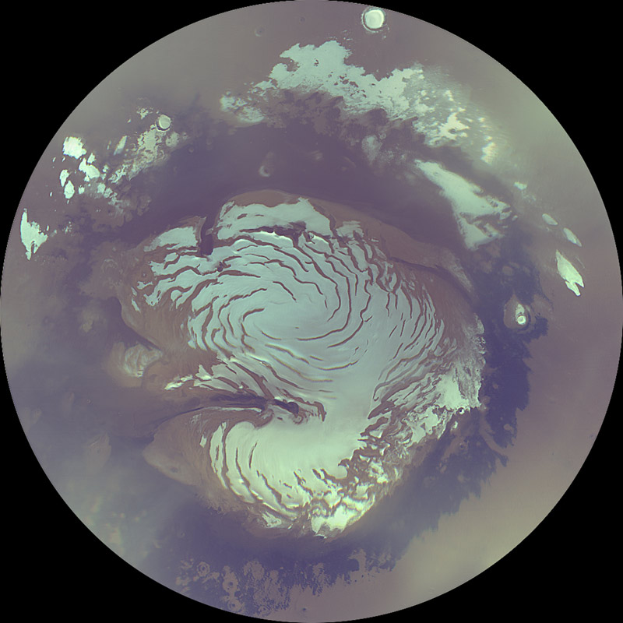
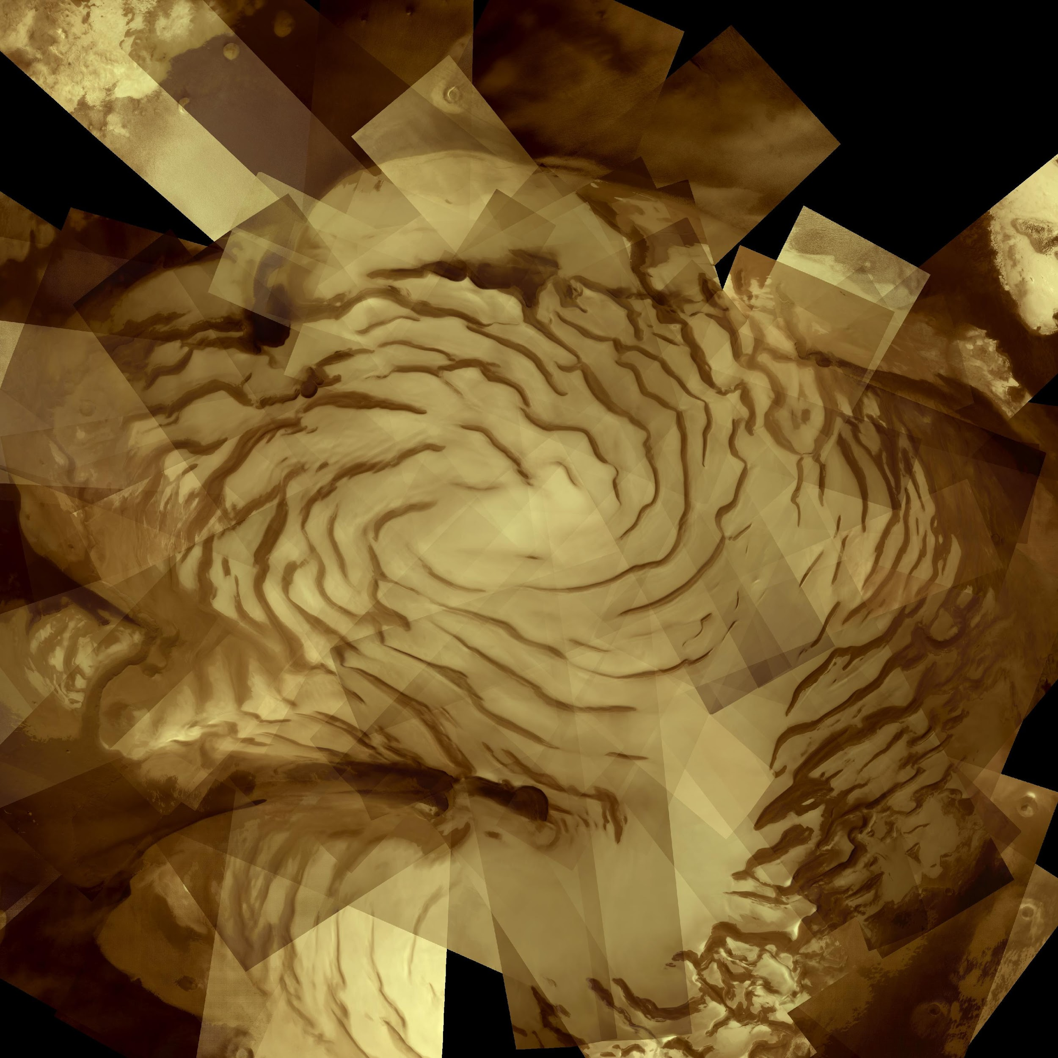
POLAR ICE CAPS
water ice + frozen carbon dioxide
South Polar Cap: 400 km diameter
North Polar Cap: 1100 km diameter
‘swiss cheese’ features
Notes:
polar caps winter: complete darkness, upto 30% of the CO2 in the atmosphere will be deposited as frozen CO2, up to a third will freeze
polar caps summer: frozen CO2 sublimates, creating winds, moving dust and water vapour. northern pole is at a lower altitude, so all the frozen CO2 disappears completely each martian summer
northern cap: dark troughs
mosaic of 57 images
swiss cheese features seen at the south pole; circular depressions that form as carbon dioxide and water ice sublimate. NP evaporates all of it’s CO2, SP doesn’t, so maybe that’s why they form (about 5km down)

Slide 22
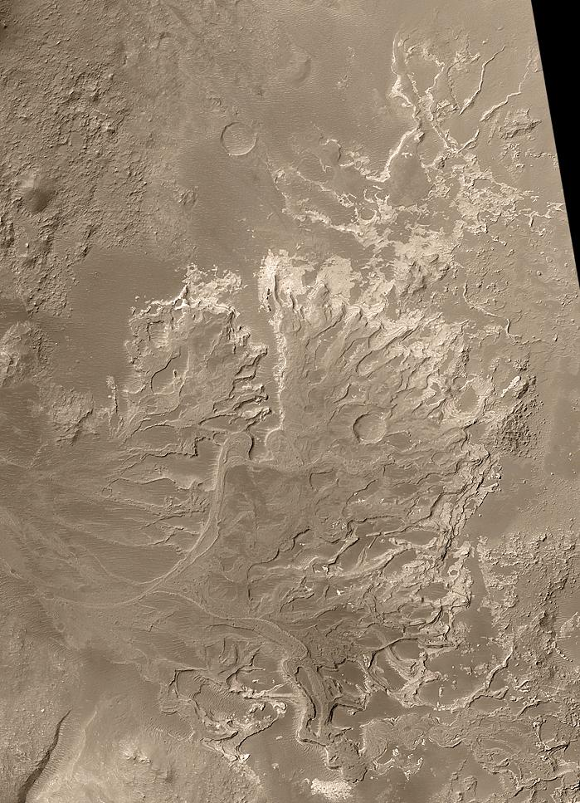
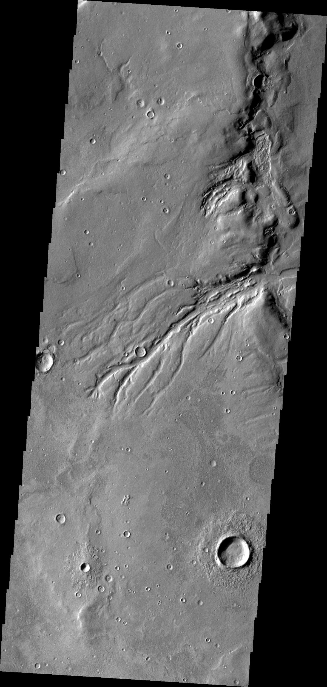
WATER
ice at the North Polar Cap (visible at the surface)
below the CO₂ at the South Polar Cap
shallow and deep subsurface
river valleys, lake basins, stream beds, rocks that could only form in water, ice patches, glaciers, atmospheric measurements, …
Notes:
no liquid water on the surface: pressure is too low and temperature is too low (would evaporate or freeze), existed in the past
in the past: denser atmosphere, warmer temperatures
many of the past missions to mars have detected water in some form, not on the surface though.
2010: 40 000 river valleys mapped, deltas, features that look very similar to what we see carved by water, minerals and rocks that can only form with water, large patches of ice in craters, evidence of glacial flows
deltas need deep water for long periods of time to form

Slide 23
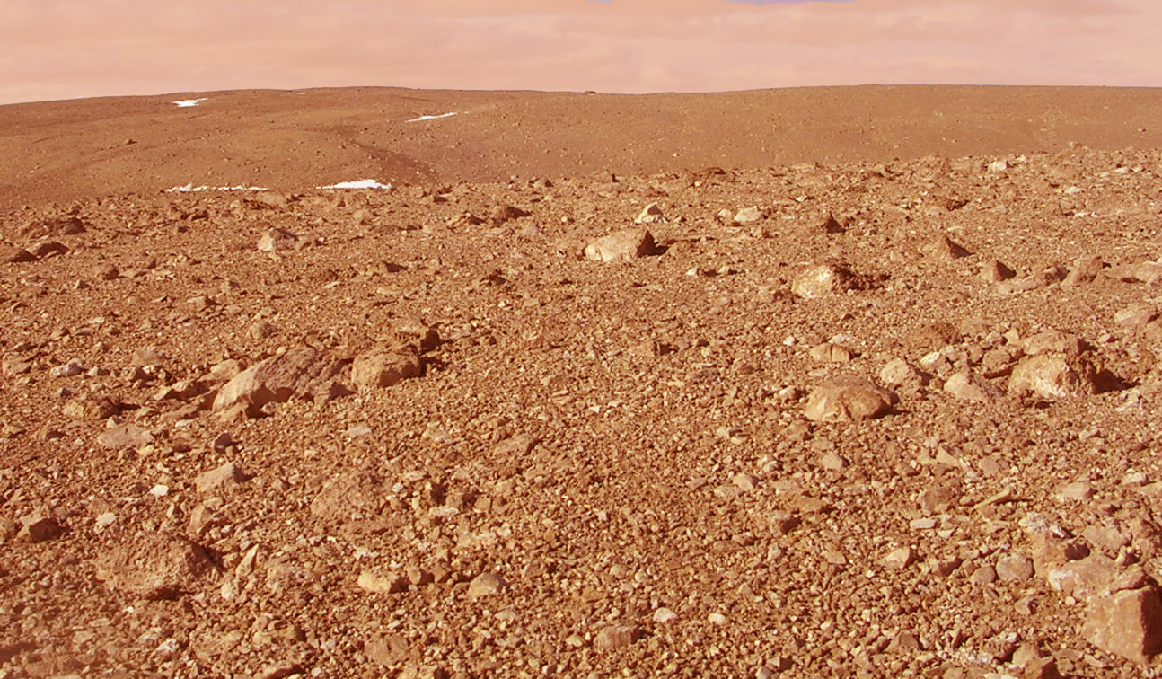
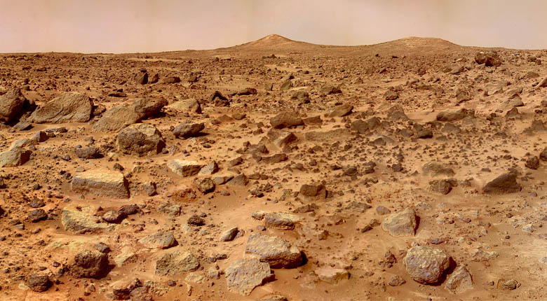
A
Earth
Mars
B
Notes:
Desert with rocks!

Slide 24
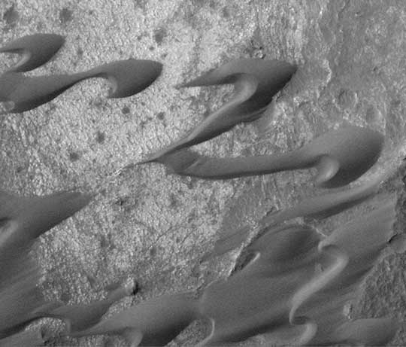
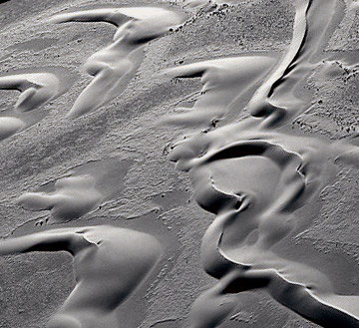
B
Sand Dunes
Mars
A
Earth
Notes:
Sand dunes

Slide 25
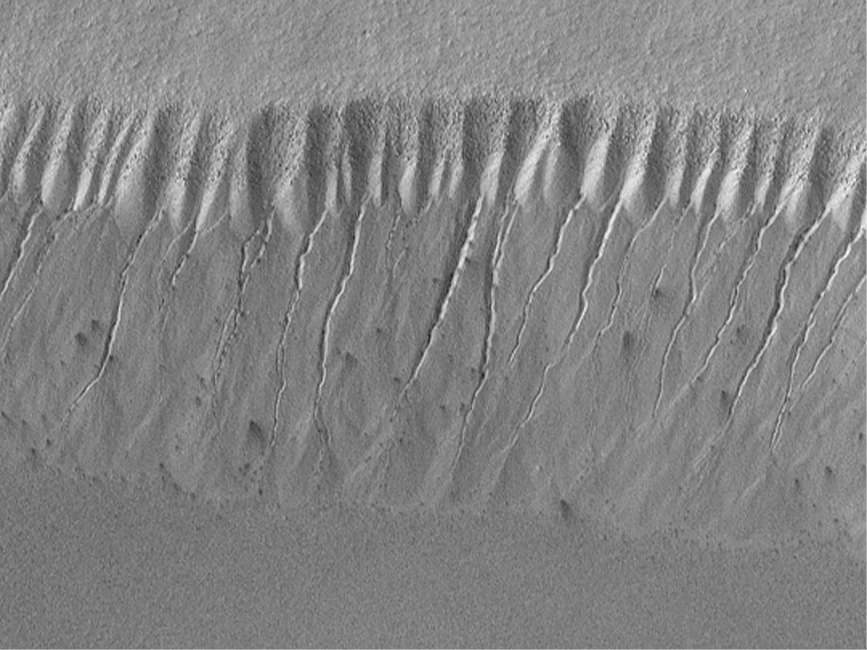
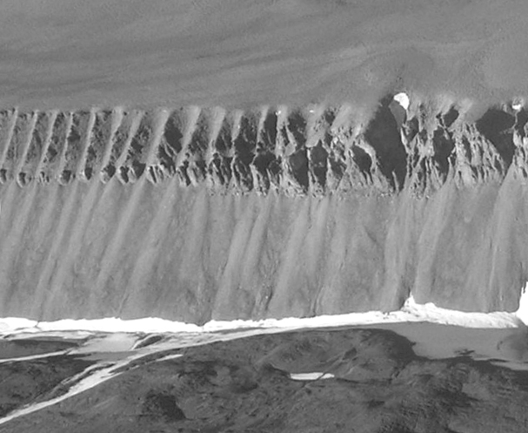
Gully
A
Mars
B
Earth
Notes:
gully landforms near the south polar region of Mars show evidence of geologically recent seepage and runoff of liquid water

Slide 26
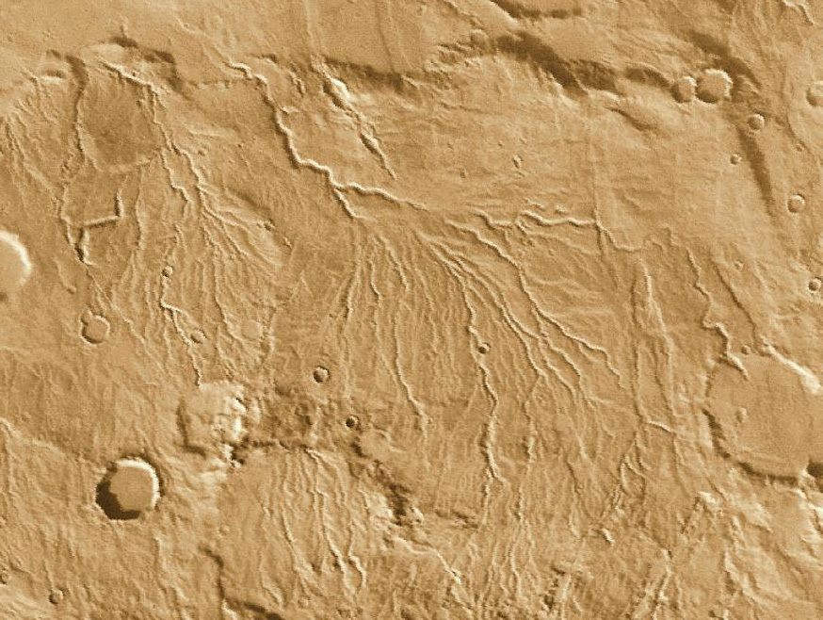
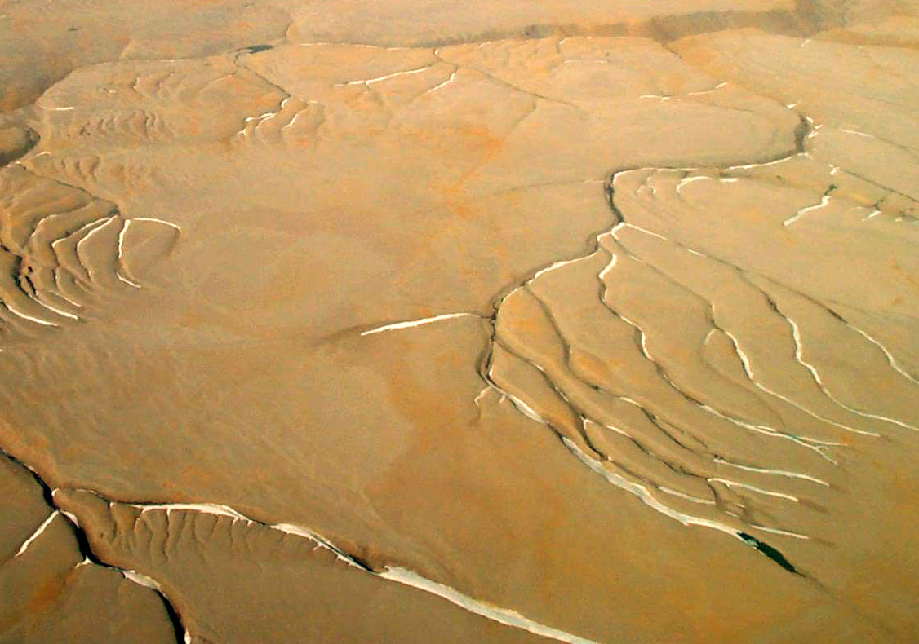
A
Water Carved Channels
Mars
Earth
B
Notes:
Water Carved channels

Slide 27
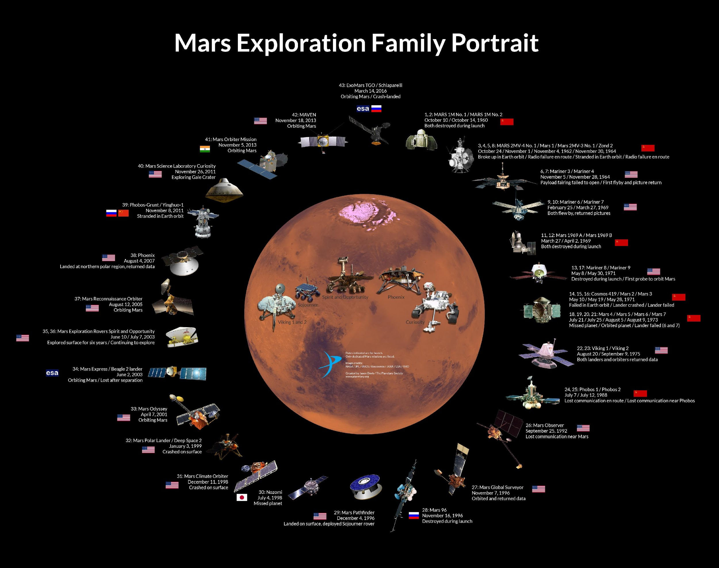
Notes:
And now to zoom forward again to our new frontier: space - Here we have the hero's circle of satellites and landers which have made it to mars.. 13 satellites have had successful missions to mars, around 20 have failed in the attempt.. 20.. Imagine.. These may seem like cold blocks of metal, but each one is in fact the eyes and in some cases, arms, of teams of scientists and engineers, sometimes as many as 500 in a team back on earth.. These teams are in fact part of our present generation of heroic adventurers.. they command their robots movements with hope for great discovery but with great risks also… we command our mars explorers in once sense blind.. It takes between 8 and 20 minutes for commands simply to reach mars, and we can't see our robotic friends at all times.. Sometimes as our two planets rotate, the robotic explorers are on the other side lost from view..
A spacecraft missing from this circle is the Japanese Nozomi, which was launched in 1998 but in the end through an engineering error flew past Mars.. This was Canada's first taste of planetary exploration, a scientist called Andrew Yau from University of Calgary built a small instrument to be carried on Nozomi.. While his experiment ultimately wasn't successful, the experience led to new partnerships with the japanese.. And laid the ground for future exploration..

Slide 28
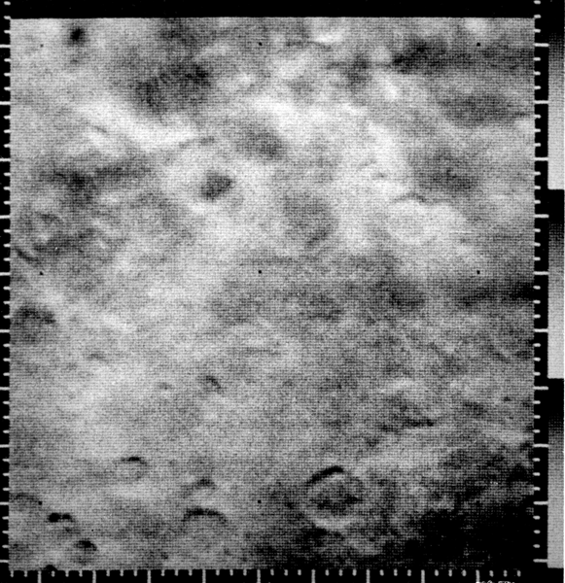
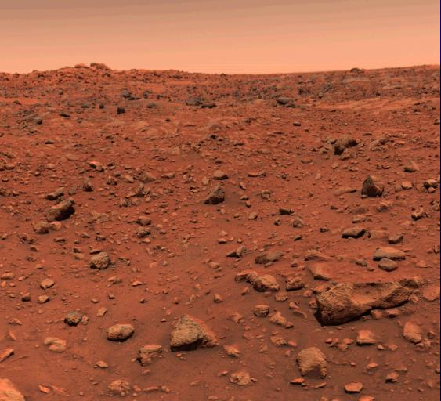
HISTORY
Mariner 4, 1965: first flyby
Viking 1, 1976: first lander
first colour photographs
Notes:
Herschel noted changing sizes of polar caps
Asaph Hall; named after the horses that pull the chariot of mars; telescope used was at 26 inch refractor (we have a 10 inch refractor)
first photo showing craters on Mars, 262 X 310 km (Mariner 4)

Slide 29
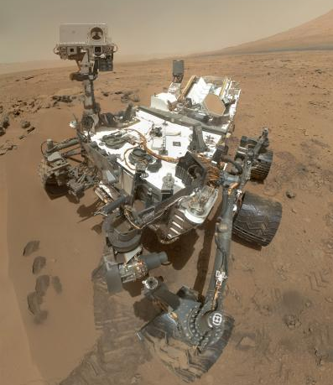
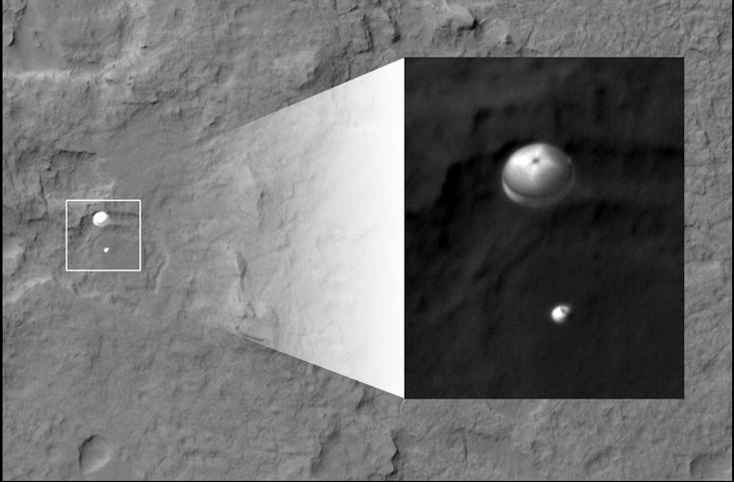
HISTORY
Current missions:
Mars Reconnaissance Orbiter (MRO)
Mars Exploration Rovers (Spirit & Opportunity)
Mars Express
Mars Odyssey
Mars Science Laboratory (MSL)
Mars Atmosphere and Volatile Evolution(MAVEN)
Notes:
selfie by Curiousity rover (MSL)
Spirit and Opportunity; landed Jan 2004, intially supposed to run for 90 martian days (just over 92 Earth days), Spirit ran until May 2011, Opportunity is still going. plan was to look at rocks/soil for water
Phoenix mission was the first to land in a polar region, planned to look at water on Mars and study the atmosphere. The LIDAR for the lander was made in CANADA (2008)
MSL landed in Gale Crater, looking at habitability, climate, and geology
photo taken by MRO of Curiousity parachuting to the surface

Slide 30
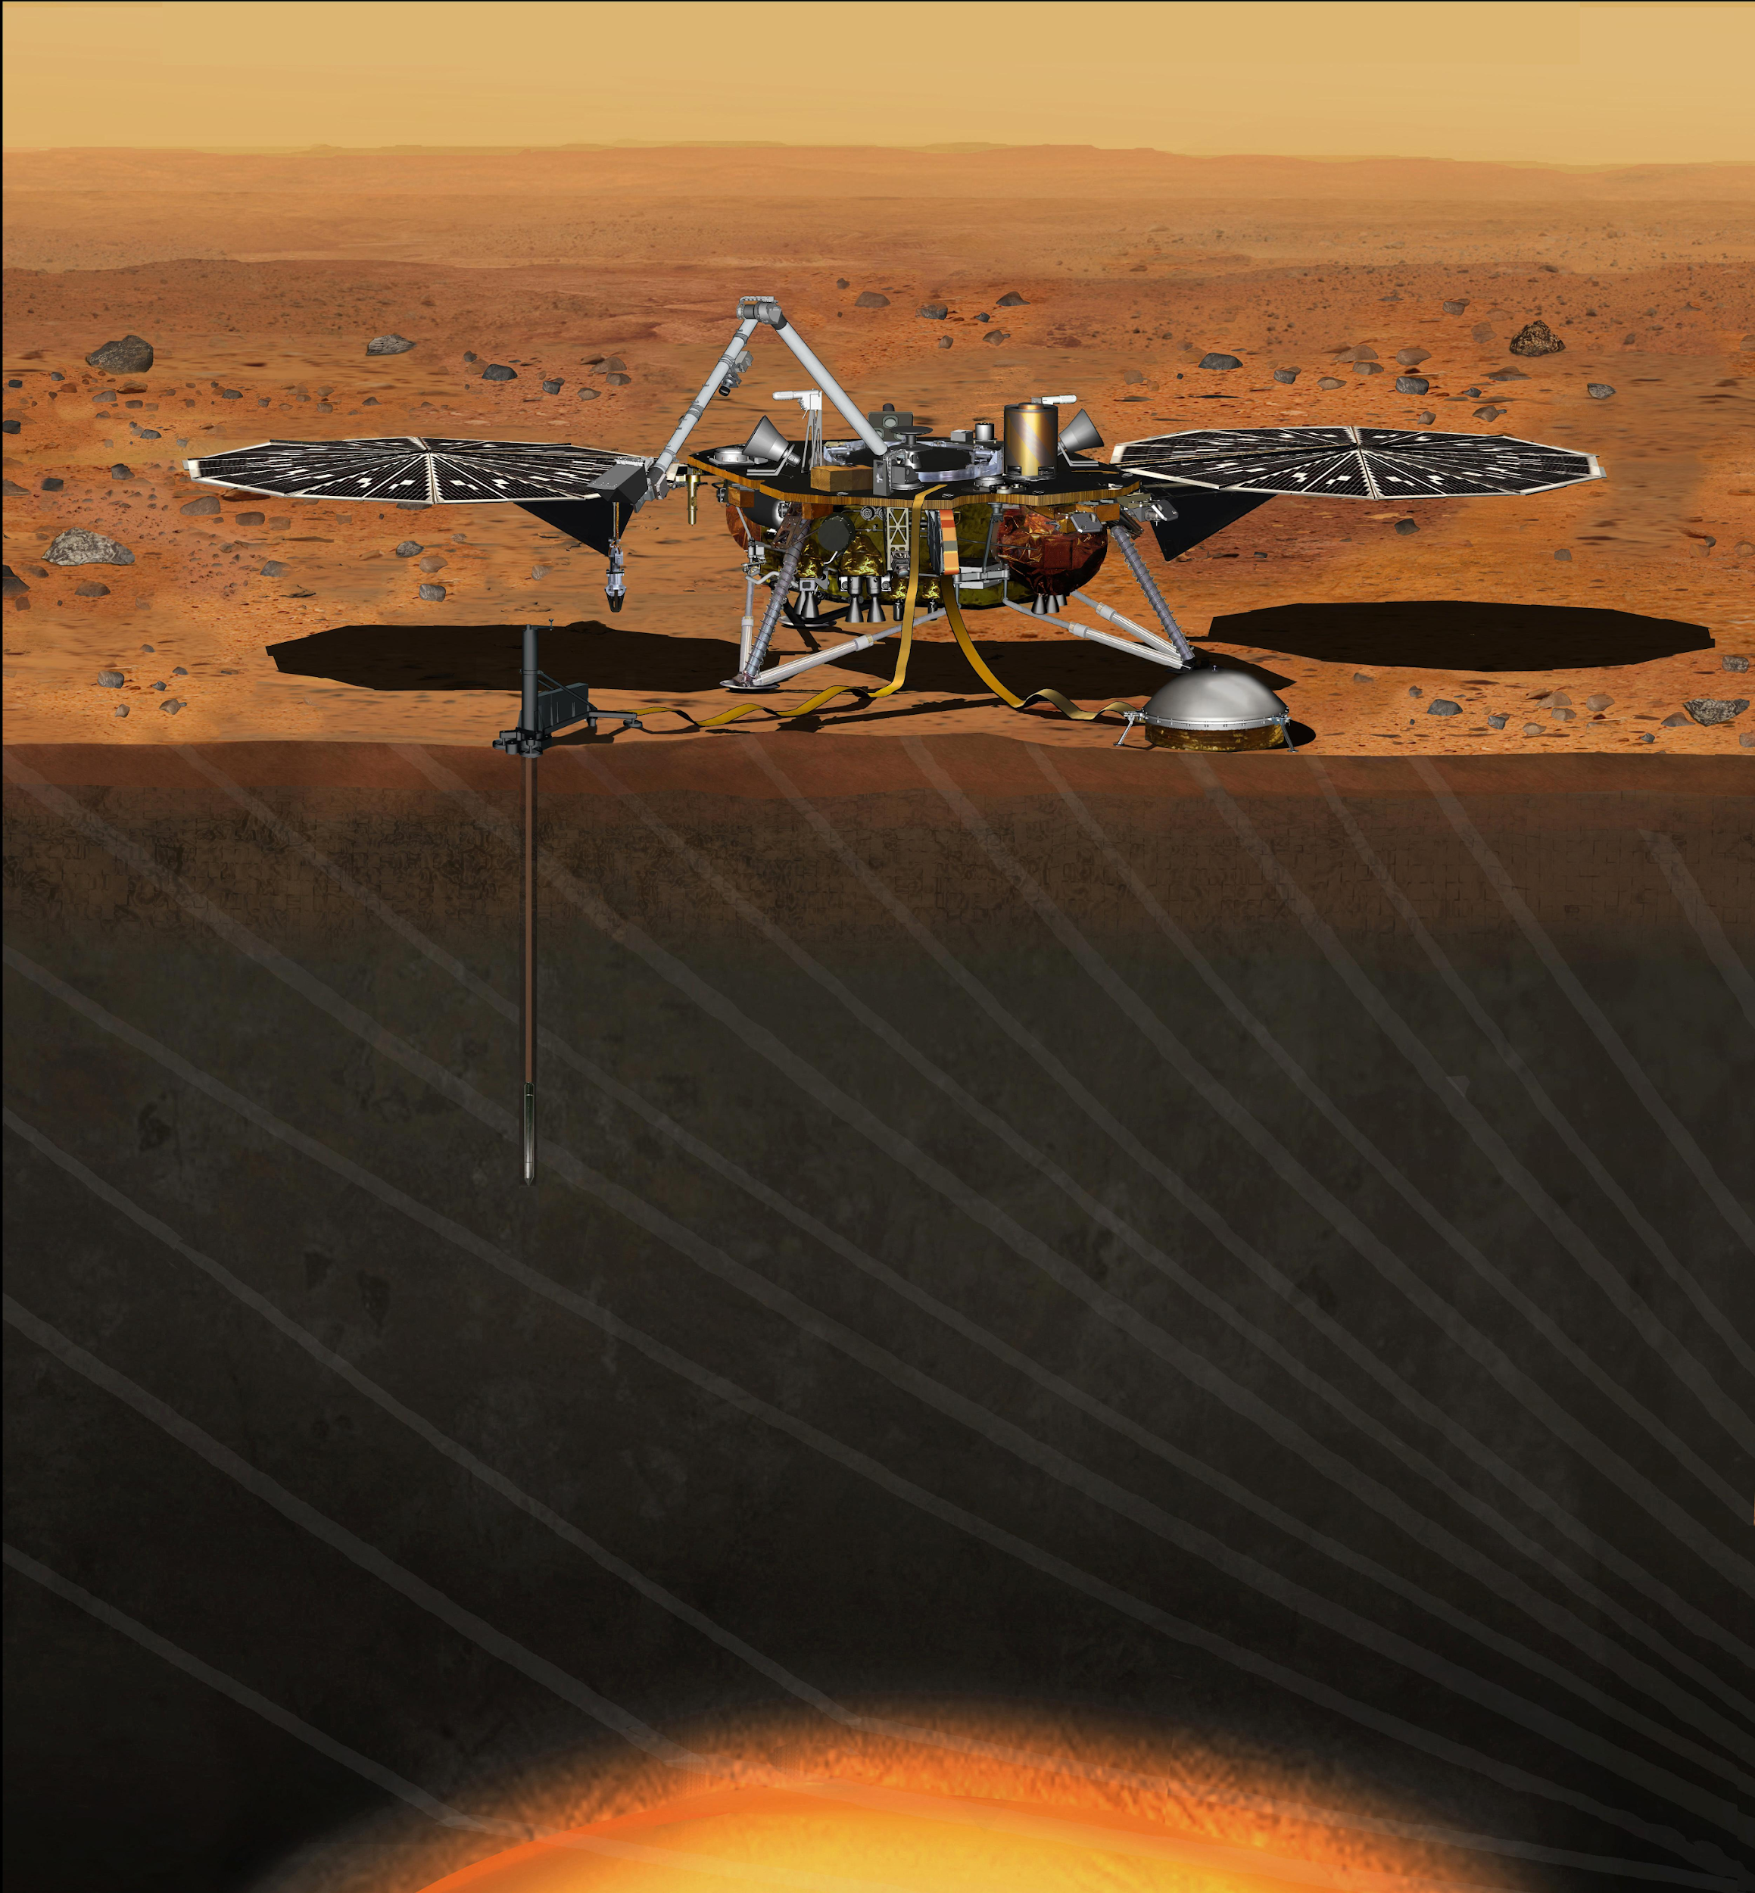
FUTURE MISSIONS
ExoMars (2016, 2018): lander, rover, orbiter
InSight (2018)
Biosignatures
Deep interior, Mars 2020
assess habitability
Notes:
exomars: astrobiology mission, ESA + russians
Insight: NASA, study the deep interior; no plate tectonics means its interior is more accurate to its history (things are changing around)
many manned mission proposals, still a long way away

Slide 31
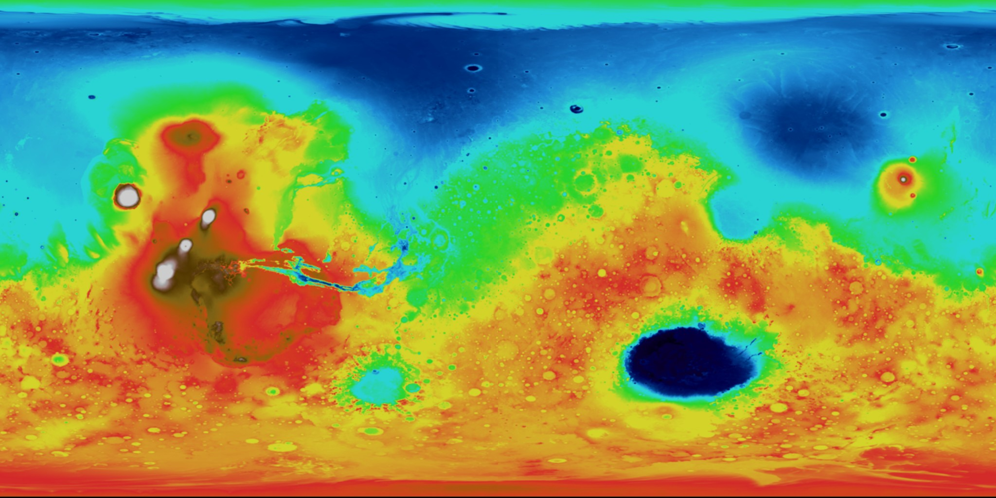
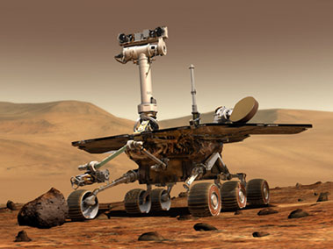
Studying & Exploring Mars
Image credit: MOLA Science Team
Notes:
So what's next?
Well, we really haven't explored much of Mars at all!
The stars show where previous landers and rovers have been – note Spirit and Opportunity, the current MER rovers.

Slide 32
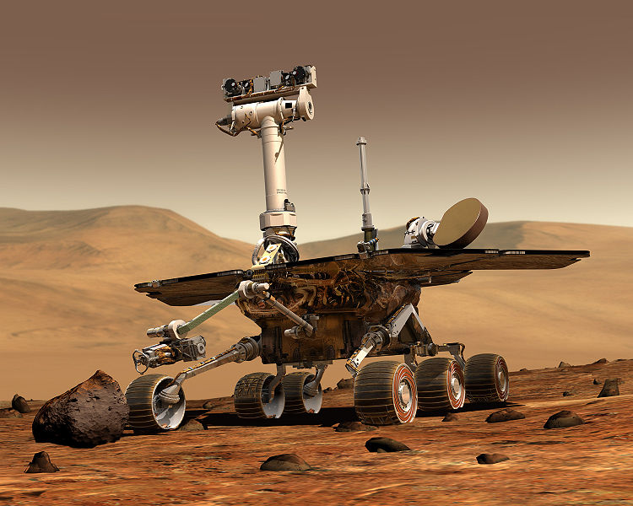
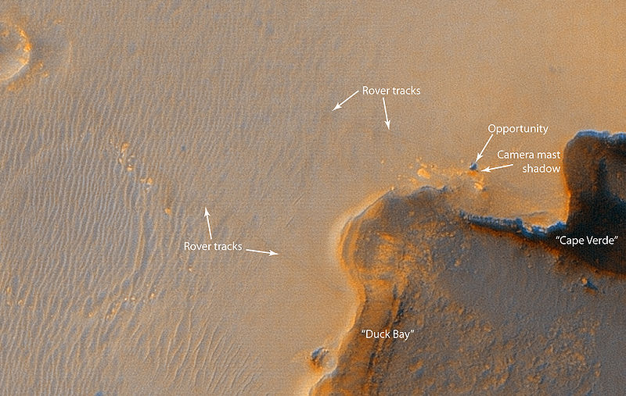
Spirit & Opportunity Rovers
…roving since 2004
Spirit went offline
on May 25, 2011

Slide 33
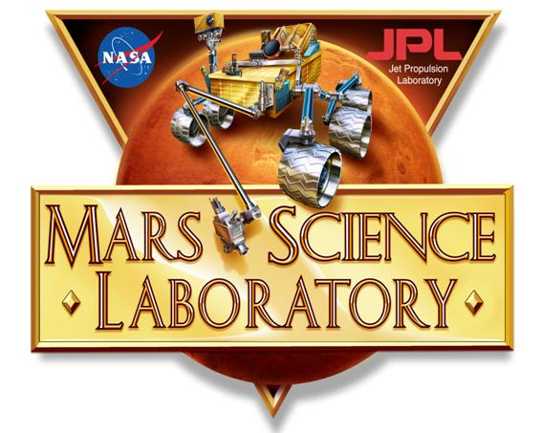
Studying & Exploring Mars
Image credit: MOLA Science Team
Notes:
Recently (November 2011), the Mars Science Laboratory (NASA) was launched, and landed in Gale crater (red start) on 6th August, 2012.
The NASA Mars Science Laboratory, carrying the Curiosity Rover, was launched in November of 2011. It landed inside Gale crater. This rover is about the size of a Volkswagon Beatle, and has many advantages over the previous rovers.
One major advantage is that it will run on nuclear power, so will be able to use many instruments at one time and will be able to work throughout the Mars winter.

Slide 34
Curiosity
Image Credit: NASA/JPL
Notes:
On the front/center is Mars Pathfinder landed in 1997
On your left is working model of opportunity and spirit, landed in 2004
On your right is the model of Curiosity, landed in 2012

Slide 35
Curiosity
HiRise Image; Credit: Nasa/JPL
Notes:
HiRise image of Curiosity Landing

Slide 36
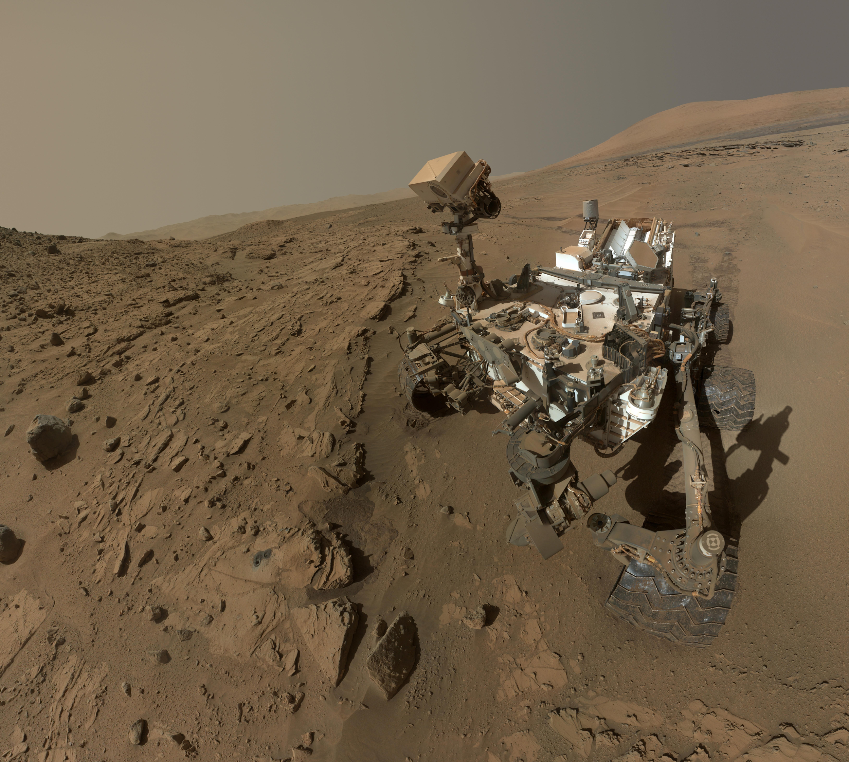
Curiosity in Gale Crater
Notes:
ST: The Curiosity rover landed on Mars in August of 2010, after an 8-month journey from Earth. This picture was taken on Mars by the rover itself! It held out its robotic arm and took a series of images with its Mars Hand Lens Imager (MAHLI) camera that were then mosaicked together to create this composite image—essentially, the rover took a selfie! This is just one of a few “selfies” the rover has taken.
Image credit: NASA/JPL-Caltech/MSSS

Slide 37
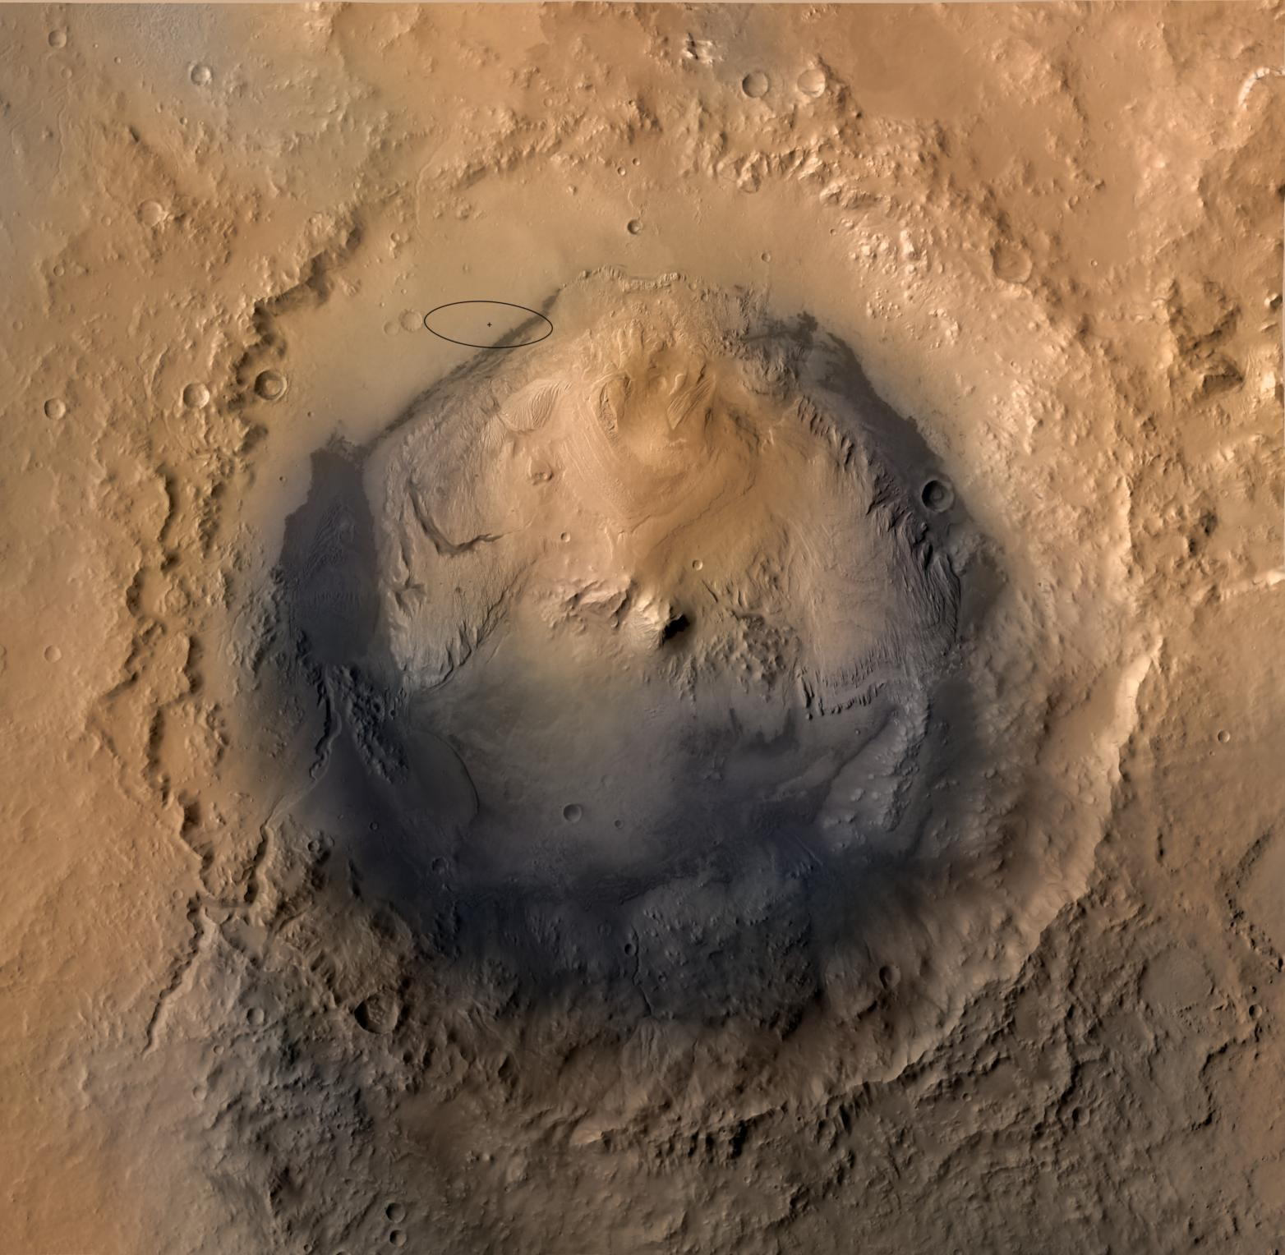
Why did we go to Gale Crater?
Good place to look for evidence of Mars’ past and/or present habitability
May have been a lake
Contains a mountain of layered rock whose lower portion is carved by channels, while upper is not 🡪 spans the transition from wet to dry Mars
Mound has minerals suggestive of water
Includes clays, which are good at preserving signs of life on Earth
Curiosity landing site
Notes:
ST: Here we’ve zoomed in on Gale Crater. The little black ellipse is where Curiosity landed within the crater. Why did scientists choose to land here? (go through bullet points on the slide)
“Habitability” = conditions suitable for life (i.e., temperature, pH, atmospheric composition, presence of water)
“Signs of life” = fossils, biomarkers (things produced by life, such as waste products/certain minerals)
Image credit: Mars Reconnaissance Orbiter Context Camera (CTX) mosaic of Gale Crater, colourised using Mars Express HRSC data (NASA/JPL-Caltech/MSSS).

Slide 38
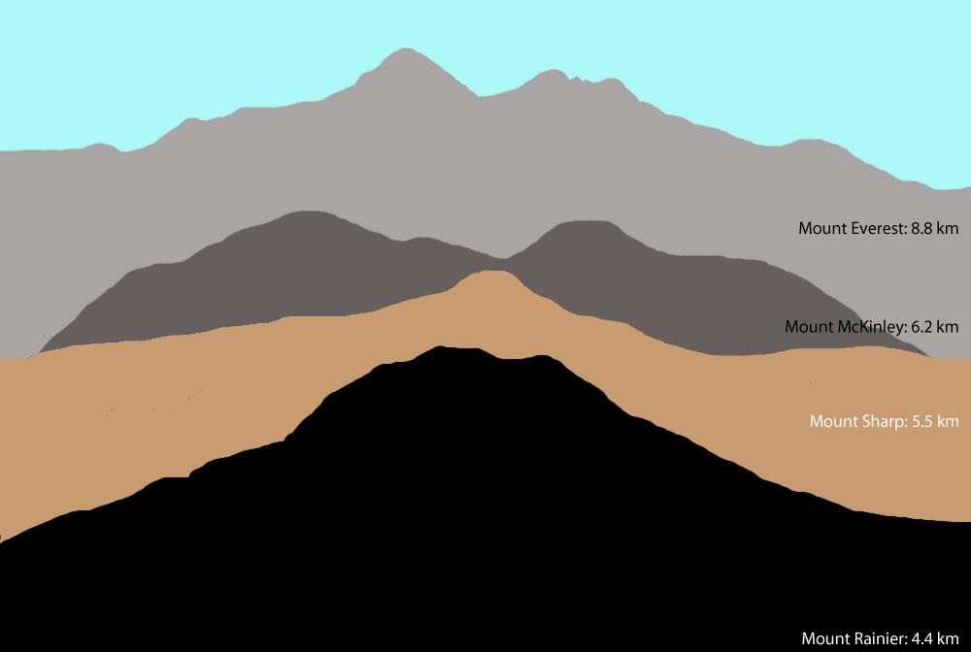
Notes:
ST: The mountain (“mound”) of layered material inside Gale Crater is informally called “Mount Sharp”.* It stands a whopping 5 km tall! To get an idea of just how tall that is, this image shows Mount Sharp compared to tall mountains here on Earth. It’s taller than Mount Rainier (near Seattle in Washington state) but shorter than Mount McKinley (the tallest mountain in North America). That’s a LOT of layers!
*Named by the Curiosity Science Team after Dr. Robert Sharp, an important figure in Mars planetary science who passed away; the mountain’s formal name is “Aeolis Mons.”
Image credit: Comparison of the heights of some mountains on Earth to Mount Sharp in Gale Crater (NASA/JPL-Caltech/MSSS/Tanya Harrison).

Slide 39
Notes:
ST: Curiosity landed in a safe, flat area away from the mound, and has been driving toward it for the past two Earth years.* The goal is for the rover to drive up the mound, inspecting the layers for signs of habitability. Just recently, the rover reached the lowest layers of the mound. The blue line in this 3D view shows the planned traverse for the rover from its landing site up Mount Sharp.
*A year on Mars is roughly 2 Earth years long—approximately 687 Earth days.

Slide 40
Notes:
ST: Curiosity took this image along its drive, looking toward Mount Sharp. It may not look very tall in the distance on the left—that’s simply because of the wide angle of the camera used to take the image.
Image credit: Mastcam mosaic (NASA/JPL-Caltech/MSSS)

Slide 41
Notes:
ST: Sometimes the rover turns around to look behind itself. These are its wheel tracks after having driven through a patch of sand in an area called “Dingo Gap.” Do you remember all of the sand dunes near the base of Mount Sharp in our maps? Notice how the sand looks very smooth compared to the rocky terrain around it.
Q: Why do you think the sand looks smooth?
A: Small grains of the sand compared to the larger rocks around it.
Image credit: Mastcam mosaic (NASA/JPL-Caltech/MSSS)

Slide 42
Notes:
This map shows the location of Dingo Gap (orange circle) relative to the large dune field at the base of Mount Sharp (black areas to the south/east). Yellow line is the rover’s traverse from landing (“Bradbury Landing” point) to sol 792 (792 Martian days since landing).
Image credit: NASA/JPL-Caltech/MSSS/UA

Slide 43
Notes:
ST: These are some more sand dunes near the base of Mount Sharp, imaged by the rover on the 55th day of its mission. It was very important for the rover scientists and engineers to know where these sand dunes are located using images from orbit as they pose a hazard—dunes are a place where rovers can get stuck. Unfortunately this is what happened to an older Mars rover, Spirit.
Image credit: Mastcam left (34 mm) (NASA/JPL-Caltech/MSSS)

Slide 44
Notes:
ST: This is a close-up view of some of the broken up pieces of the very lowest exposed portions of Mount Sharp. The cracks likely formed when the rocks dried and contracted, as observed on Earth in certain rocks in dry conditions. Think about mud when it dries—it tends to form cracks like these.
Image credits: Left—Curiosity Navigational Camera (Navcam) of the rover arm drilling a sample (NASA/JPL-Caltech). Right—MAHLI view of the drill area (NASA/JPL-Caltech/MSSS).

Slide 45
LIFE ON MARS?
if it exists, we haven’t found it (yet)
search for evidence of life is now a NASA objective
Notes:
life on earth requires water, so if mars had water in the past, could there be life, or could life have existed on mars?
NASA motto “Follow the water” was successful (lots of evidence of water) has now turned to “Seek Signs of Life”
look for anything that could be seen as evidence of life (gases in the atmosphere, fossils, complex organic molecules)
Claims to microbial life: meteorite ALH84001 found in Antarctica 1984 , ejected from Mars 17 million years ago. structures that could have been fossils of microbial bacteria 1996. lots of controversy, not believed
life on the surface: lots of radiation (no magnetic field to protect against radiation), frozen – unlikely
subsurface could be a good place to look

Slide 46
Curiosity
Notes:
Three scientists from the CPSX are part of the Curiosity science team (Dr. John Moores, a post-doc, and Raymond Francis and Emily McCullough, two PhD students). They will be going down to mission control and collaborating with other scientists.

Slide 47
THE FUTURE…..
1914 2001 2033?
Notes:
This top picture shows us a nice link between exploring in the past and where we are today.
A hundred years ago people explored by sailing ship.. And were completely dependent on the weather.. In the bottom pictures you can see some images from Shacketon's expedition in 1914 to try to cross Antarctica.. Look at the three guys standing beside all their gear – Does anyone here think it would be cool to be one of a team of explorers standing on parts of a new continent for the very first time?
Now our next frontiers are in space.. Canadian modern day space explorers – astronauts - have already gone for a spacewalk from the US space shuttle – here is a picture of Canadian astronaut, Chris Hadfield in 2001.. Not exactly the same clothing and tools is it, but the same spirit of adventure I think!
Chris is one of only a few people in the whole world who have walked in space.. But what we are going to talk about today – and what a lot of people are starting to talk about - is the next step.. A human expedition to the planet Mars…

Slide 49
This could be you!
Notes:
And so to the future to conclude:
By studying Mars analogues on Earth we hope to learn more about Mars, so that when humans do set foot on Mars, we will have at least some understanding of the Red Planet!
Hopefully within the next 20 years, we’ll have humans setting foot on Mars… and I certainly wouldn’t mind being one of them!
Scientific reasons behind this go without saying!
However, I also believe that space represents one of the last great frontiers – would be a great adventure, like Columbus (or the Vikings) sailing off to discover the new world!!!
I also strongly believe that a Mars mission will be a truly international effort and will be something that the entire planet can get behind and draw inspiration from – something that is needed in our day and age, when all we seem to do is to fight one another…

Slide 50
Studying & Exploring Mars
Image credit: MOLA Science Team
Notes:
The red star shows where the Mars Phoenix Lander landed
Introduce Phoenix.

Slide 51
Phoenix Mars Lander
Who NASA
CSA (co-contributor) What A mission to explore the Martian arctic When Launch: August 2007 Arrival: June 2008
Offline: May 2010 Where Launch Site: Kennedy Space Center Landing Site: North Polar region
Notes:
NASA mission Phoenix Mars Lander will left Earth in August 2007 and reached Mars in June 2008.
CSA is played an important role in this mission since it is responsible to deliver the meteorological instrument (MET) which will composed the lander's payload.

Slide 52
Notes:
And now to zoom forward again to our new frontier: space - Here we have the hero's circle of satellites and landers which have made it to mars.. 13 satellites have had successful missions to mars, around 20 have failed in the attempt.. 20.. Imagine.. These may seem like cold blocks of metal, but each one is in fact the eyes and in some cases, arms, of teams of scientists and engineers, sometimes as many as 500 in a team back on earth.. These teams are in fact part of our present generation of heroic adventurers.. they command their robots movements with hope for great discovery but with great risks also… we command our mars explorers in once sense blind.. It takes between 8 and 20 minutes for commands simply to reach mars, and we can't see our robotic friends at all times.. Sometimes as our two planets rotate, the robotic explorers are on the other side lost from view..
A spacecraft missing from this circle is the Japanese Nozomi, which was launched in 1998 but in the end through an engineering error flew past Mars.. This was Canada's first taste of planetary exploration, a scientist called Andrew Yau from University of Calgary built a small instrument to be carried on Nozomi.. While his experiment ultimately wasn't successful, the experience led to new partnerships with the japanese.. And laid the ground for future exploration..

Slide 53
http://www.windows2universe.org/mars/mars_orbit.html

Slide 54
How can we study climate change on Mars?
=> Comparative Planetology
Notes:
One of the main ways we can study other planets is actually using our knowledge gained from exploring Earth!
This is something we term "comparative planetology".
So now we're going to look at some of the images sent back by these various spacecraft and compare with similar landforms on Earth.
Does everyone understand what I mean by landforms?
A: Landforms are basically any feature we see on the surface of a planet. E.g., river valley, mountain, etc.

Slide 55
Notes:
But not everywhere on Mars looks like Earth does it?!!
Mars is cold and dry, so we go to some of the coldest, driest places on Earth – the world's polar deserts!
So does anyone know where in the world this may be?
A: Devon Island.

Slide 57
A
Polygonal Ground
Mars
Earth
B
Notes:
Polygonal Ground- generally attributed to to the alternate freezing and thawing of soil layers containing water or ice

Slide 58
Thank you!
Questions?

